Slide 1






Introduction to Metadata
Rebecca Brown, Griffith University
17th August 2016
Notes:
We’re going to be spending the rest of the day learning how to add new resources to the NAB Portal. And when you add new resources to the portal, you’re going to be asked to provide a variety of information that describes the resource you’re adding. And this descriptive information or documentation is known as metadata.
So before you start adding resources to the Portal, I wanted to give a bit of background on exactly what metadata is and share some tips for creating good quality metadata.
Why do we spend time describing the resources we want to make available via the Portal? Why do we not just dump 100s of files into a big folder? The reasons are twofold.
Firstly we need to give people a quick and easy way of finding relevant information, whether they’re searching via the NAB Portal, or the PCCP, or via a search engine like Google.
Secondly, we want people to be able to understand what a resource is all about, decide whether it would be useful to them and how they would use it – without them having to download a large file or read a long report.

Slide 2


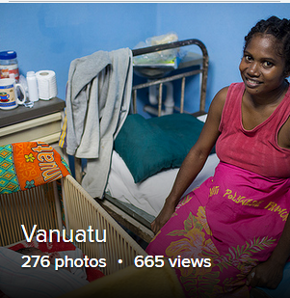

Metadata – what is it?
Metadata is structured information which describes a “thing”, e.g. a report, a photo, a person
Metadata can also describe intangible things, e.g. a project, an event
Metadata can describe individual items or collections of similar items, e.g. a photo album
Notes:
What is it? Metadata is structured information which describes a “thing” or an item of some kind. The item in question could be a report, a photograph, a dataset, or even a person.
You’re probably familiar with the information you find in Library catalogues – that’s metadata. In the catalogue we don’t find the physical book, but we can read a description of it which helps us to decide whether it’s worth going to the shelf and looking at it.
Metadata can also describe intangible things, like projects, organisations or events.
Metadata can describe individual items or collections of similar items. E.g. a report, a photo, a project.
(e.g. a series of articles, an album containing related photographs, a data collection consisting of lots of datasets, an aid programme consisting of a number of projects).
Every time we locate something on google, or in a catalogue or a filing cabinet or a repository like the NAB Portal, it’s because someone has gone to the bother of describing it using metadata.

Slide 3
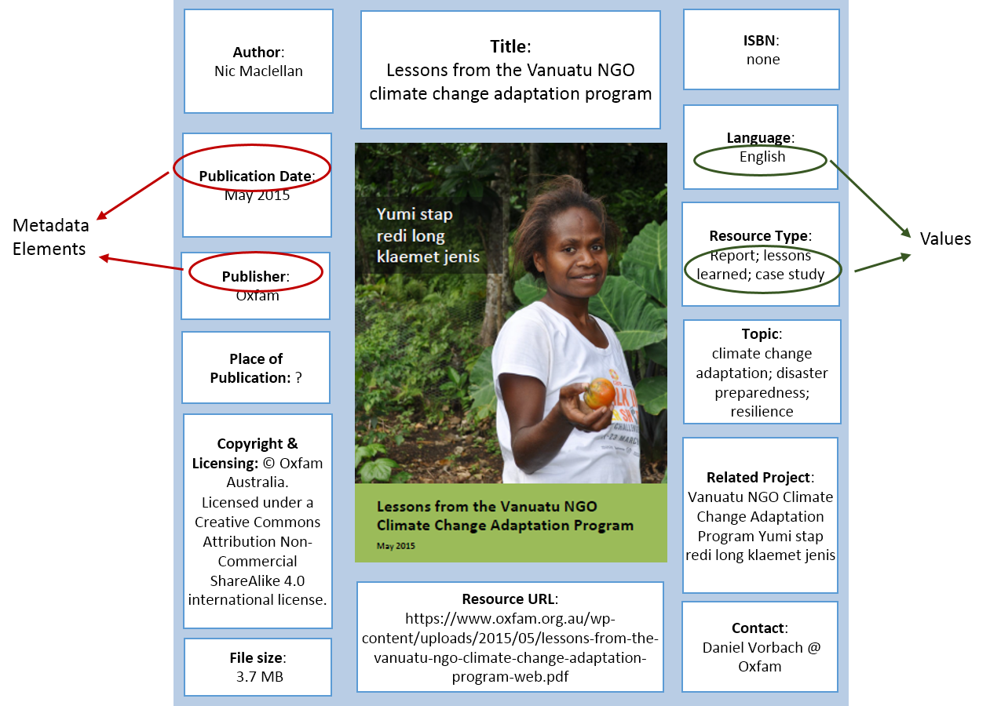
Metadata example
Notes:
Here’s an OXFAM report – that’s the “Thing” or the “item” itself. Around it you can see all the metadata that tells us about the item.
It gives us all the documentation and descriptive information that we would need to locate, understand, evaluate and use this report.
It gives us a sense of what it’s about, how up to date it is, and how authoritative it is.

Slide 4
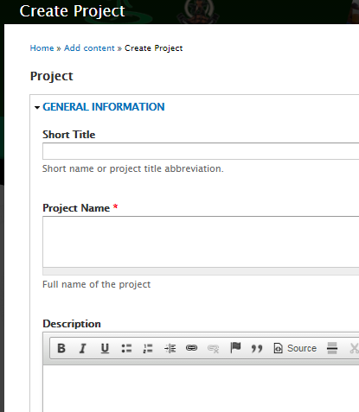

Metadata Creation
Manual creation – filling out online form, using a software program, embedding in or appending to a file, recording in separate file
Automatic embedding – MS Word, MS Excel, digital cameras, scientific instruments
Notes:
Metadata can be created automatically or manually.
Today we’re going to be creating metadata manually, by filling out a form. Sometimes you might also create metadata by adding extra information to a document, or recording extra information in separate file. For example a dataset might be accompanied by a text file that gives some explanatory information about the data.
Metadata can also be created automatically. For example, when you take a photo or create a file on your computer – information about your photo or file is automatically recorded. This is known as “Embedded metadata”.

Slide 5
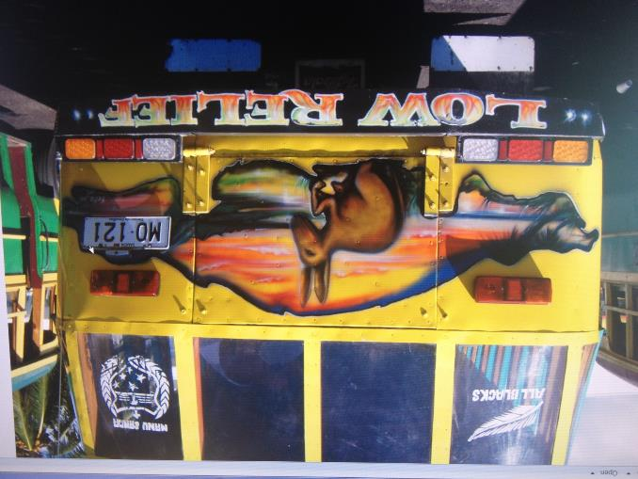
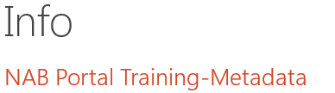
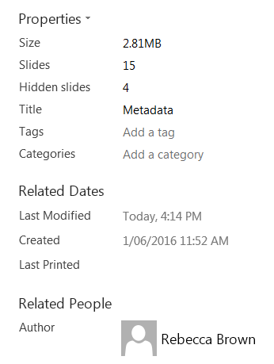
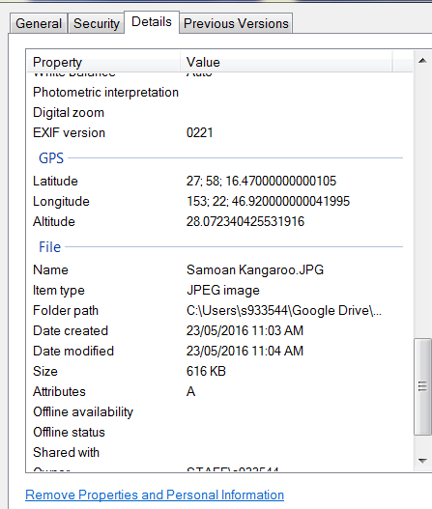
Embedded metadata

Slide 6
Creating Metadata
Locate
Understand
Evaluate
Use
Data:
How?
What?
Where?
When?
Why?
Locate
Understand
Evaluate
USE
Notes:
To create quality metadata, you need to include all the documentation and descriptive information that someone would need to locate, understand, evaluate and use an item.
Depending on what sort of thing or resource you’re describing, you may need to provide different sorts of information.
Datasets and data collections typically need more explanatory information than other types of resources.
How was data collected?
What instruments were used?
Where? When? Why?
What software is needed to read it?
Has the data been transformed in any way?
What are the measurement units?

Slide 7
Metadata
Document | Map | Dataset | Organisation | Project
Title | Title | Title | Name | Project name
Author | Creator | Creator | Type | Funding body
Publisher | Contributors | Where and why was data collected | Address | Implementing organisation
Publication Year | Publisher | Start and finish dates for data collection | Contact person | Project start and finish date
Place of Publication | Publication Year | Instruments used to collect data | Purpose/Role | Implementing country
ISBN | Edition | Authenticity of data |  | Project site
Language | Geographic Location | Software needed to read data |  | Funding amount
Topics/subject keywords | Scale | Other related datasets |  | Contact person
Summary | Map Type | Summary |  | Type of project
File type and size | Purpose | Data custodian |  | Project description
Access details | Projection | File type and size |  | Relevant documentation
Copyright and licensing | Copyright and licensing | Access details |  | Link to project website
 |  | Copyright and licensing
Notes:
Different types of things or resources need different metadata so we can understand them. Here are a few examples.
Map types: reference map, thematic, topographic, cadastral, navigation

Slide 8
Nab Portal - content types
Contacts
Documentsetc
News
Events
Projects
Organisations
Notes:
Today we’re going to be practising creating metadata records for different types of content in the NAB Portal. The Portal stores lots of different types of content – these are the ones that will be of most relevance to you.
When you add a new record to the portal, you also get the opportunity to link it to other records. So for Example, a Project can be linked to a Document, a Contact Person or an Organisation.
An Organisation can be linked to a Project, a Document, a News Item or an Event.
And a Contact person can be linked with an Organisation.

Slide 9

Poor quality metadata
Title: Chapter 16. Vanuatu
Description: This report describes the future climate of Vanuatu.
Topic: Climate change
File name: Chapter_16.pdf
Notes:
What does good quality metadata look like?
Example of poor quality metadata for a chapter out of a major report.

Slide 10
Good quality metadata
Title: Climate Variability, Extremes and Change in the Western Tropical Pacific: New Science and Updated Country Reports 2014- Chapter 16. Vanuatu
Description: This report, a major output of the PACCSAP Programme, documents the latest scientific understanding of large-scale climate processes, observations, extremes and projections in the western tropical Pacific. This chapter focuses specifically on Vanuatu. It provides a climate summary, information on seasonal cycles, observed trends and climate projections.
Publisher: Australian Bureau of Meteorology and CSIRO
Publication Date: 2014
ISBN: 978-1-4863-0289-5
Topics/keywords: Climate change science, climate projections, meteorology and weather, Vanuatu, Pacific, PACCSAP
File name: PACCSAP_CountryReports2014_Ch16Vanuatu_140710.pdf
Related Information: The complete report and country chapters can be found at http://www.pacificclimatechangescience.org/publications/reports/climate-variability-extremes-and-change-in-the-western-tropical-pacific-2014/
Notes:
Here’s the same chapter, with good quality metadata added.

Slide 11
Think about your audience
  How will they be looking for the item?
  What keywords would they use to search for an item?
  What will they need to know in order to understand or use an item?
  Are there any characteristics of the resources that will be of particular interest to them? E.g.
    will they be looking for case studies, lessons learned or scientific articles?
    Will they be looking for items that relate to a particular geographic location?
Notes:
Creating good quality metadata can take time and effort, but it’ll also save time and effort in the long run, by making information easier to discover and use.
When you’re creating metadata, You should start by thinking about your target audience and their needs as information users.

Slide 12
Good practice tips
Use clear, descriptive writing
Create a meaningful title that conveys as much information as possible using the least number of words
Use standard and consistent terminology for dates, languages, countries, and organisation names.
Select descriptive keywords that explain the subject matter of the item. Include “topic” keywords and “place” keywords.
Use a controlled vocabulary or thesaurus as a source of keywords.
Notes:
Use clear, descriptive writing and avoid jargon where possible.
If you are in charge of naming an item, make sure you create a meaningful title that conveys as much information as possible using the least number of words.
For digital items, create good file names that are brief but meaningful. Avoid the use of spaces, symbols or characters that might be misinterpreted by a computer, e.g. !, @, <, >, (, ).
Use standard and consistent terminology for dates, languages, countries, and organisation names. For example, when creating metadata for reports published by the UNDP, decide on whether you are going to write the publisher name as “United Nations Development Programme” or “UNDP”. Once you’ve made a decision, try to stick to it.
Select descriptive keywords that explain the subject matter of the item. Use a controlled vocabulary or thesaurus as a source of keywords if possible. Include “topic” keywords and “place” keywords.

Slide 13
The PCCP Topics vocabulary
Is a controlled vocabulary or “thesaurus”
Was designed for use in the PCCP and the NAB Portal
Uses standard terms for climate change, DRR and other subject areas
Has 20 top-level topics, each with sub-topics
You will need to choose at least one topic for every item you add to the Portal
Notes:
I want to finish up by mentioning the PCCP Topics Vocabulary that you’ll be using in the NAB Portal.

Slide 14
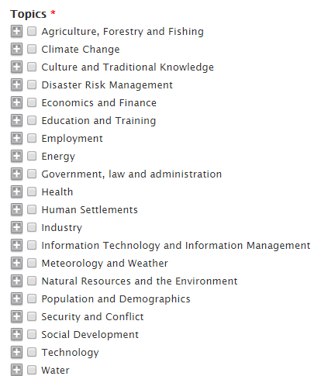
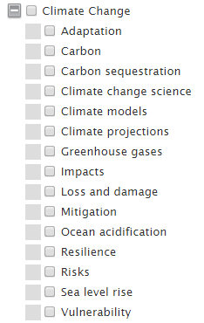
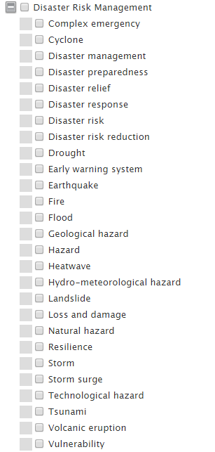
Notes:
You have the option of choosing a top-level or a second level topic. You can choose as many as you like. If you choose a second-level topic, the top level will automatically be selected.

