Slide 1
COP23 Delegate Induction
10 August 2017
Department of Women’s Affairs Conference Room
9am – 11am

Slide 2
Introductions
Name
Department
Is this your first time representing Vanuatu at the climate negotiations?
UNFCCC Taskforce | COP23 | DT01_Induction
Notes:
UNFCCC Taskforce starts introductions
Go around the circle until everyone has answered
Also pass around a packet of M&Ms – ask everyone to take one and don’t eat it yet (each M&M colour matches to a different question)

Slide 3
Introductions
And one more…
Green M&M—Where do you like to go on weekends?
Blue M&M—What’s your favourite hobby?
Orange M&M—What’s your favourite movie of all time?
Brown M&M—Why do you care about climate change?
Yellow M&M—If you were the President for a day, what would you do?
Red M&M—Who do you admire the most?
UNFCCC Taskforce | COP23 | DT01_Induction
Notes:
Go around the circle once more
Note: should finish this activity by 9:15

Slide 4
Republic of Vanuatu Delegation to COP23
Twenty-three official delegates
8 Senior Government officials
8 Government officials
1 academic representative
2 development partner representatives
2 private sector representatives
2 civil society representatives
4 affiliated negotiators
across seven thematic areas
Climate Finance
Adaptation
Loss and Damage
Mitigation
Implementation of the Paris Agreement
Gender
Non-Party Stakeholders
Head of Delegation—Deputy Prime Minister, Joe Natuman
UNFCCC Taskforce | COP23 | DT01_Induction
Notes:
Give basic introduction to our Delegation—explain that the Taskforce aimed to have greater diversity in our national representation this year, and therefore have 10 delegates that represent the Government of Vanuatu’s partners
Explain that the next training session will explain the thematic areas in depth
Everyone will have name tags with coloured dots. This leads into the next activity—
Break out into thematic work groups by finding everyone with the same coloured dot as you.

Slide 5
Thematic Work Groups
All delegates have been grouped according to their technical expertise
The majority of the Delegation’s work in preparation for COP23 will be carried out in these thematic work groups
Each thematic group is lead by a senior Government official
All delegates must follow the instructions of the Head of their thematic work group or the Head of Delegation or the Alternate Heads of Delegation
UNFCCC Taskforce | COP23 | DT01_Induction
Notes:
Ask each group to spend 5 minutes sharing their experience with this particular issue
For example, does it relate to their work in Vanuatu? Have they studied it, or does their work support Vanuatu’s policy goals in this area?
Note: should finish this activity by 9:30

Slide 6
The NAB and UNFCCC Taskforce
The National Advisory Board on Climate Change & Disaster Risk Reduction (NAB) is the supreme policy making and advisory body for all CC and DRR programs in Vanuatu
The NAB also advises the Government of Vanuatu on its engagement with the United Nations Framework Convention on Climate Change (UNFCCC)
This work is carried out by the UNFCCC Taskforce, and supported by the NAB Secretariat
UNFCCC Taskforce | COP23 | DT01_Induction
Notes:
UNFCCC Taskforce comprised of:
Ministry of Foreign Affairs
Department of Women’s Affairs
Ministry of Finance
Ministry of Climate Change
Representative of GIZ ‘Coping with Climate Change in the Pacific Island Region Programme’
Representative of civil society

Slide 7
The NAB and UNFCCC Taskforce
The UNFCCC Taskforce was endorsed by the NAB at its first sitting this year, and has met 2-3 times per month since then
Its primary role is to “..assist, plan, share information about, seek finance for and delegate the implementation of all initiatives related to Vanuatu’s engagement with the UNFCCC.”
The UNFCCC Taskforce is responsible for:
Recruiting and coordinating the COP23 Delegation
Making nominations for meetings and workshops
Preparing delegates for regional and international meetings
Facilitating the development of submissions to the UNFCCC
Engaging with Government partners to increase public awareness about the UNFCCC and climate action in Vanuatu
UNFCCC Taskforce | COP23 | DT01_Induction
Notes:
UNFCCC Taskforce comprised of:
Ministry of Foreign Affairs
Department of Women’s Affairs
Ministry of Finance
Ministry of Climate Change
Representative of GIZ ‘Coping with Climate Change in the Pacific Island Region Programme’
Representative of civil society

Slide 8
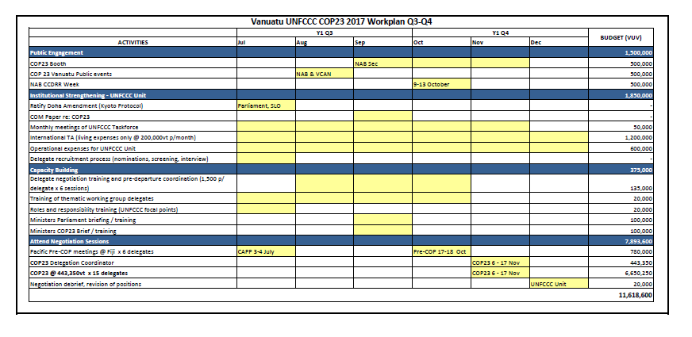
The NAB and UNFCCC Taskforce
The UNFCCC Taskforce 2017 Work Program is divided into four broad activity areas:
1. Public Engagement
2. Institutional Strengthening
3. Capacity Building
4. Negotiations
UNFCCC Taskforce | COP23 | DT01_Induction

Slide 9
The NAB and UNFCCC Taskforce
Under its 2017 Work Programme, the Taskforce is working to:
Increase the diversity of representation on the COP23 Delegation, by recruiting representatives from civil society, private sector and academia;
Enhance collaboration between Vanuatu and other Pacific Island nations, including Fiji as incoming President of COP23
Improve delegate reporting after all meetings under the UNFCCC
Facilitate the development of national position papers and submissions
Ensure that all UNFCCC activities are aligned with the National Sustainable Development Plan (NSDP) and CCDRR Policy
Improve planning for the 2018 Facilitative Dialogue and COP24 through improved reporting and delegate debriefs
UNFCCC Taskforce | COP23 | DT01_Induction
Notes:
Achievements in 2017 so far—
Recruited the COP23 Delegation, with representatives from all national sectors
Created tools and training to help delegates prepare UNFCCC submissions and position papers
Collaborating with regional partners on a side-event at COP23 to highlight the leadership of ni-Vanuatu women in climate change actions
Facilitating funding and training opportunities for delegates

Slide 10
Expectations
Break out into groups of 3
Share your expectations of COP23:
What do you think the negotiations will be like?
What do you think your role will be as a delegate?
What are you worried about?
What are you excited for?
If you have been to a COP in the past, share some stories about your experience there
UNFCCC Taskforce | COP23 | DT01_Induction
Notes:
Assign 10 minutes to this activity

Slide 11
Expectations
Contracts
The Government of Vanuatu has strict expectations of all its national delegates.
Your legal obligations are set out in the COP23 Delegate Contract.
Attend all COP23 trainings, meetings and events—this is a priority
Respect all confidential information relating to Vanuatu’s negotiating positions
Respect the Head of Delegation and Alternate Head of Delegation
Follow the Code of Conduct under the Public Service Act (1998)
Contribute fully to the work of the Delegation, including reporting requirements.
UNFCCC Taskforce | COP23 | DT01_Induction
Notes:
Spend 10 minutes going through the Delegate Contracts (everyone has been emailed a copy of this document already)
Delegates to sign before leaving Induction

Slide 12
Expectations
Communication
Reply promptly to all email communication sent from the UNFCCC Taskforce or NAB Secretariat and your thematic work group
RSVP for all trainings, events and meetings
Know what resources are available on the COP23 Google Drive
Please check that the UNFCCC Taskforce has the right contact details for you, including current email and mobile number(s)
UNFCCC Taskforce | COP23 | DT01_Induction
Notes:
Need everyone to check that the UNFCCC Taskforce has their contact details—most reliable email address and mobile number
Everyone should have a Google account—will be in contact to set up delegation accounts

Slide 13
Training Schedule
Training opportunities
Training is available to all COP23 Delegates
The UNFCCC Taskforce has organised an in-house training schedule
Seven training sessions:
Induction
Introduction to COP23
Skills Training x 3
Debrief
A Participation Certificate is available to all delegates that complete this in-house training
UNFCCC Taskforce | COP23 | DT01_Induction
Notes:
Printed copies of this Schedule to be given out

Slide 14
Delegate Calendar
Includes important COP23 dates
Available on the COP23 Google Drive
Be familiar with all important deadlines and check the calendar regularly as dates will change and new events will be added
Delegates are expected to regularly meet with their thematic work groups, and to agree on a work schedule to meet all assigned deadlines (e.g. UNFCCC submission due dates)
The “UNFCCC Submissions Schedule” is also available on the Google Drive
UNFCCC Taskforce | COP23 | DT01_Induction
Notes:
Printed copies of this Schedule to be given out

Slide 15
Questions?
UNFCCC Taskforce | COP23 | DT01_Induction

Slide 16
Next delegate training ! Monday 28 August
UNFCCC Taskforce | COP23 | DT01_Induction

Slide 17
Key contacts: Chair of UNFCCC Taskforce: Sanlan Williams Strategic Manager of NAB Sec: Anna Bule NAB Sec: nab@meteo.gov.vu
UNFCCC Taskforce | COP23 | DT01_Induction

Slide 18
Thank you
UNFCCC Taskforce | COP23 | DT01_Induction

