Slide 1
COP23 Training Series Introduction to the UNFCCC
4 September 2017
Vanuatu Meteorological & Geo-Hazards Conference Room
2:00 – 4:00pm

Slide 2
Welcome
Name
Department
What’s one question you have about COP23 or the UNFCCC?
UNFCCC Taskforce | COP23 | DT02_The UNFCCC
Notes:
Especially important that people who missed the Induction are able to introduce themselves to the rest of the delegation
Go around the circle until everyone has answered

Slide 3
Introduction to the UNFCCC
The Framework Convention on Climate Change
Instruments under the UNFCCC
Technical Bodies of the UNFCCC
Vanuatu’s thematic priorities
UNFCCC Taskforce | COP23 | DT02_The UNFCCC

Slide 4
Before we begin
There are two very important concepts under the international climate change regime (the collection of international laws and mechanisms that address climate change).
According to the UNFCCC:
Mitigation means “responding to climate change by reducing greenhouse gas (GHG) emissions and enhancing carbon sinks and resevoirs.”
Adaptation means “adjusments in ecological, social or economic systems in response to actual or expected climatic stimuli and their effects or impacts. It refers to changes in processes, practices and structures to moderate potential damages or to benefit from opporunities associated with climate change.”
UNFCCC Taskforce | COP23 | DT02_The UNFCCC

Slide 5
Before we begin
Simply put:
Adapation means changes to human or ecological systems because of climate impacts that are happening now or in the future that are meant to limit damage and maximise opportunities caused by climate impacts.
and
Mitigation is any effort to reduce carbon emissions, like building renewable energy sources (solar or wind farms) or protecting natural carbon stores, like oceans and forests.
UNFCCC Taskforce | COP23 | DT02_The UNFCCC

Slide 6
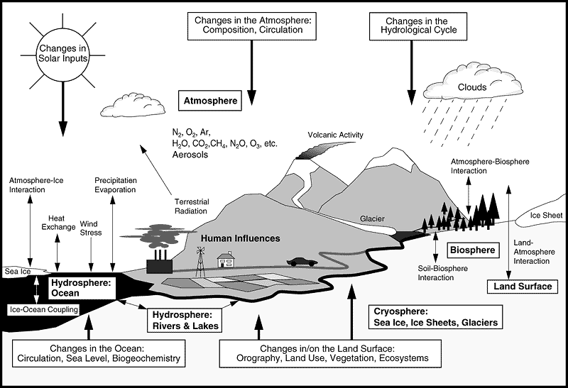
Before we begin
The UNFCCC also talks about the climate system. The IPCC (we’ll talk about them later) defines the climate system as:
“An interactive system consisting of five major components: the atmosphere (air), the hydrosphere (rivers and lakes), the cryosphere (sea ice and glaciers), the land surface and the biosphere (areas occupied by living organisms), forced or influenced by external forcing mechanisms (including the sun and human activities).”
Source: IPCC, 2001 <https://www.ipcc.ch/ipccreports/tar/wg1/040.htm>
UNFCCC Taskforce | COP23 | DT02_The UNFCCC

Slide 7
The UN Framework Convention on Climate Change
The United Nations Framework Convention on Climate Change was adopted at the Rio Earth Convention in 1992, and entered into force on 21 March 1994
Since 1992, 197 Parties have ratified (agreed to implement) the UNFCCC
The UNFCCC is a landmark international agreement.
It sets an ambitious goal: to stabilise greenhouse gas emissions to prevent dangerous climate change, to allow ecosystems to adapt, to protect food production, and to enable sustainable economic development (Article 2)
It recognises that a safe climate is the common interest of all nations
But also acknowledges that developed countries are historically responsible for anthropogenic climate change, and so should drive climate action
The specific needs and vulnerabilities of developing countries are also recognised and addressed through a range of mechanisms
UNFCCC Taskforce | COP23 | DT02_The UNFCCC

Slide 8
The UN Framework Convention on Climate Change
The objective of the Convention is set out in Article 2:
The ultimate objective of this Convention and any related legal instruments (i.e. the Paris Agreement) that the Conference of the Parties (COP) may adopt is to achieve, in accordance with the relevant provisions of the Convention, stabilization of greenhouse gas concentrations in the atmosphere at a level that would prevent dangerous anthropogenic interference with the climate system.
Such a level should be achieved within a time-frame sufficient to allow ecosystems to adapt naturally to climate change, to ensure that food production is not threatened and to enable economic development to proceed in a sustainable manner.
UNFCCC Taskforce | COP23 | DT02_The UNFCCC

Slide 9
The UN Framework Convention on Climate Change
The guiding principles of the Convention are set out in Article 3:
1. Protect the climate system for the benefit of present and future generations of humankind, on the basis of equity and the principle of common but differentiated responsibilities and respective capabilities.
2. Specific needs and special circumstances of developing country Parties should be given full consideration, especially those that are particularly vulnerable to adverse climate impacts.
3. Parties should take [comprehensive and cost-effective] precautionary measures to anticipate, prevent or minimise the causes of climate change and mitigate its adverse effects… Lack of full scientific certainty should not be used as a reason for postponing such measures.
UNFCCC Taskforce | COP23 | DT02_The UNFCCC
Notes:
CBDR is a very important legal principle, which recognises that climate change is a common problem but that developed countries should adopt the main burden of mitigating its adverse impacts and funding adaptation. This is because the historic emissions of developed countries are primarily responsible for global warming

Slide 10
The UN Framework Convention on Climate Change
4. Parties have a right to, and should, promote sustainable development. Policies and measures…should be appropriate for the specific conditions of each Party and be integrated with national development programmes, taking into account that economic development is essential for adopting measures to address climate change.
5. Parties should cooperate to promote a supportive and open international economic system that would lead to sustainable economic growth and development in all parties, particularly developing country Parties, thus enabling them better to address the problems of climate change.
UNFCCC Taskforce | COP23 | DT02_The UNFCCC

Slide 11
The UN Framework Convention on Climate Change
In summary, the principles of the UNFCCC recognise:
That all coutries rely on a safe climate and sustainable economies;
That all Parties should mitigate greenhouse gas emissions;
That some countries are especially vulnerable to adverse climate impacts, including developing countries and those phsyically vulnerable to environmental phenomena (such as small island developing states);
Developing countries (Non-Annex I Parites) have a right to sustainable development, economic growth, and extra help to meet their obligations under the Convention and to adapt to the adverse impacts of climate change;
Developed countries (Annex I Parites) have extra responsibilities under the Convention to transition to zero-carbon economies and to help developing countries to mitigate their emissions and adapt to adverse climate impacts.
UNFCCC Taskforce | COP23 | DT02_The UNFCCC

Slide 12
The UN Framework Convention on Climate Change
Parties to the UNFCC are categorised as Annex I, Annex II or non-Annex I Parties. These categories have different obligations and rights under the Convention.
Annex I Parties are classified as industrialised (developed) countries that are members of the OECD (Organisation for Economic Cooperation and Development) and “economies in transition” (EIT). There are 43 Annex I Parties to the UNFCCC, including the European Union.
Annex II Parties are the OECD members of Annex I, but not the EIT Parties. Annex II Parties are required to provide financial resources to enable developing countries to undertake emissions reductions and to fund adaptation initiatives.
Non-Annex I Parties are mostly developing countries, for which special provisions are made under the UNFCCC (e.g. technology transfer and adaptation finance).
Least developed countries (LDC) are Non-Annex I Parties that are given extra special consideration, given their limited capacity to respond to climate change and adapt to its adverse effects.
UNFCCC Taskforce | COP23 | DT02_The UNFCCC

Slide 13
The UN Framework Convention on Climate Change
There are three tiers of commitments under the UNFCCC, in accordance with the principle of common but differentiated responsibilities. All Parties must:
Submit reports that track domestic GHG emissions—Article 4.1(a)
Implement national and regional mitigation programmes—Article 4.1(b)
Cooperate to develop, apply and share technology that controls, reduces or prevents GHG emissions—Article 4.1(c)
Cooperate to manage, conserve and enhance GHG sinks and reservoirs—Article 4.1(d)
Prepare for adaptation to adverse climate impacts—Article 4.1(e)
Include climate change in social, economic and environmental policies and actions, including those intended to mitigate or adapt to climate change—Article 4.1(f)
Promote and cooperate in climate research and data archives—Article 4.1(g)
Promote and cooperate in the full, open and prompt exchange of all information relevant to climate change—Article 4.1(h)
Promote and cooperate in education, training and public awareness—Article 4.1(i)
UNFCCC Taskforce | COP23 | DT02_The UNFCCC

Slide 14
The UN Framework Convention on Climate Change
Developed country Parties have additional obligations under the Convention.
Annex I Parties must:
Adopt and implement national mitigation policies that demonstrate developed countries are taking the lead in the global effort to prevent dangerous global warming;
Submit national communications with detailed information about their mitigation policies and measures; and
Coordinate with other Annex I Parties to develop economic and administrative instruments to facilitate the UNFCCC’s objective.
Annex II Parties have the further obligation to:
Provide new and additional finance, including technology transfer, to:
Meet the full costs incurred by developing country Parties when they implement their obligations under the Convention; and
Meet adaptation needs of developing country Parties.
UNFCCC Taskforce | COP23 | DT02_The UNFCCC

Slide 15
Technical Bodies of the UNFCCC
The work of the UNFCCC is carried out by bodies that are comprised of political representatives and technical experts.
Political
Conference of the Parties (COP)
The COP serving as the meeting of the Parties to the Kyoto Protocol (CMP)
The COP serving as the meeting of the Parties to the Paris Agreement (CMA)
Technical Bodies
Subsidiary Body for Scientific and Technological Advice (SBSTA)
Subsidiary Body for Implementation (SBI)
Ad-Hoc Working Group on the Paris Agreement (APA)
UNFCCC Taskforce | COP23 | DT02_The UNFCCC
Notes:
The COP, CMP, CMA, SBSTA, SBI and APA are each responsible for different topics under the UNFCCC, and so each have their own agenda at COP23
These draft agendas are available on the COP23 Homepage: http://unfccc.int/2860.php

Slide 16
Technical Bodies of the UNFCCC
Technical Bodies cont.
Adaptation Committee (AC)
Adaptation Fund Board (AFB)
Advisory Board on the Climate Technology Centre and Network (CTCN)
Executive Committee, Warsaw International Mechanism for Loss & Damage (WIM)
Paris Committee on Capacity-Building (PCCB)
Least Developed Countries Expert Group (LEG)
Technology Executive Committee (TEC)
Standing Committee on Finance (SCF)
Global Environment Facility (GEF)
Green Climate Fund (GCF)
Intergovernmental Panel on Climate Change (IPCC)
See your workbook for more information about each of these bodies.
UNFCCC Taskforce | COP23 | DT02_The UNFCCC

Slide 17
Technical Bodies of the UNFCCC
Each body has a specific area of responsibility under the UNFCCC, and conducts meetings and consultations throughout the year to take decisions according to their mandates. For example, at Bonn in November:
The 23rd Conference of the Parties (COP 23) must, inter alia: [provisional agenda]
Receive reports from the technical bodies (SBSTA, SBI and APA)
Discuss finance matters (long-term climate finance, report of the GCF, etc.)
The 47th Meeting of SBSTA (SBSTA 47) must, inter alia: [provisional agenda]
Produce further guidance in relation to NDCs (including features and accounting)
Produce further guidance in relation to adaptation communications (including as a component of NDCs)
The 47th Meeting of SBI (SBI 47) must, inter alia: [provisional agenda]
Hear matters relating to national adaptation plans and least developed countries
Receive reports from Annex I and non-Annex I Parties
UNFCCC Taskforce | COP23 | DT02_The UNFCCC

Slide 18
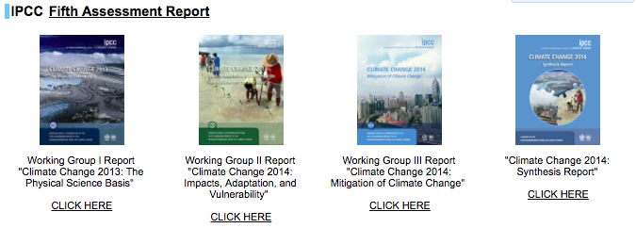
Intergovernmental Panel on Climate Change (IPCC)
The Intergovernmental Panel on Climate Change (IPCC) is the international body for assessing the science related to climate change.
The IPCC was established in 1988 by the World Meteorological Organisation (WMO) and UN Environment Programme (UNEP)
Its purpose is to provide policymakers with regular assessments of the scientific basis of climate change, its impacts and future risks, and options for adaptation and mitigation.
The IPCC regularly assesses all available climate science. These assessment reports provide a scientific basis for governments at all levels to develop climate-related policies.
UNFCCC Taskforce | COP23 | DT02_The UNFCCC

Slide 19
Instruments under the UNFCCC
Several legal instruments (binding agreements) have been negotiated by the Conference of the Parties (COP) to implement the broad goals of the UNFCCC.
The Kyoto Protocol
The KP was adopted at COP3 in December 1997, and entered into force (became binding under international law) in February 2005.
The KP commits Parties to emission reduction targets. To meet these targets, Parties had to cut their domestic carbon emissions from energy, agriculture and other sectors
The first committment period under the KP ran from 2008 to 2012. The second commitment period started in 2012 and will run until 2020.
After this time, the nationally determined contributions submitted under the Paris Agreement will come into effect.
The Doha Amendment introduced the second committment period, which had more ambitious targets for Annex I Parites who ratified the Amendment (ratify means to sign).
UNFCCC Taskforce | COP23 | DT02_The UNFCCC

Slide 20
Instruments under the UNFCCC
The Paris Agreement
The PA was adopted at COP21 in November 2015, and entered into force in November 2016. The PA entered into force in record time, which reflects the strong global commitment to climate action.
The PA aims to “strengthen the global response to the threat of climate change by keeping a global temperature rise this century to well below 2°C above pre-industrial levels, and to pursue efforts to limit the temperature increase to 1.5°C.”
The PA also aims to strengthen the ability of countries to deal with the impacts of climate change.
To achieve its ambitious goals, the PA seeks to establish appropriate financial flows, a new technology framework and an enhanced capacity building framework to support developing countries.
UNFCCC Taskforce | COP23 | DT02_The UNFCCC

Slide 21
Instruments under the UNFCCC
Point of interest
Vanuatu was one of the first Parties to ratify the Paris Agreement on 22 April 2016, with the following Declaration:
“…The Government of the Republic of Vanuatu declares that, in light of best scientific information and assessment on climate change and its impacts, it considers the emission reduction obligations in Article 3 of the Kyoto Protocol, the Doha Amendment and the Paris Agreement to be inadequate to prevent global temperature increase of 1.5 degrees Celsius above pre-Industrial levels and as a consequence, will have severe implications for our national interests...”
UNFCCC Taskforce | COP23 | DT02_The UNFCCC
Notes:
Can link this back to the Suva Declaration (Pacific Leaders issued it through PIDF in 2015)
And the ongoing position from AOSIS and Pacific Leaders that 1.5 is the absolute maximum warming that many low-lying countries will be able to survive;
See also 1.5 report from IPCC due 2018

Slide 22
Instruments under the UNFCCC
The PA requires all Parties to make and communicate their best efforts to meet the global long-term temperature goal (to limit global warming to below 2°C above pre-industrial levels, and to make serious efforts to limit warming to 1.5°C).
These efforts are called Nationally Determined Contributions (NDCs).
The content of NDCs are not prescribed.
Each Party to the UNFCCC determines its own targets: the idea is that every Party will do the most it can to meet the collective 1.5°C target.
UNFCCC Taskforce | COP23 | DT02_The UNFCCC

Slide 23
Instruments under the UNFCCC
Vanuatu’s Nationally Determined Contribution
Vanuatu’s first NDC contains a sector-specific mitigation target: to generate 100% of Vanuatu’s electricity from renewable energy sources by 2030.
This target was established by Vanuatu’s National Energy Road Map (NERM)
Vanuatu’s NDC also reiterates the national adaptation targets set out in the National Adaptation Programme of Action (NAPA) and the national Climate Change and Disaster Risk Reduction (CCDRR) Policy.
A summary of Vanuatu’s national and sectoral climate change policies is available from the NAB Secretariat
UNFCCC Taskforce | COP23 | DT02_The UNFCCC
Notes:
Can also note that Vanuatu MCCA PMU is developing an updated National Adaptation Plan with support from GCF Readiness and UNEP
Need to get an update on this – can we ask Brian to come and deliver 5 minutes on the NAP?

Slide 24
Instruments under the UNFCCC
Implementation Guidelines for the Paris Agreement
The PA was adopted by the COP at COP21, however further decisions are required on a range of topics before the PA can be implemented.
The PA and Decision1/CP.21 (a decision taken by the COP in 2015) made the APA, SBI and SBSTA responsible for making these decisions.
You can find the provisional COP23 meeting agendas for these bodies here.
Collectively, these decisions will create the Implementation Guidelines for the Paris Agreement, a detailed “rule book” for Parties to follow.
The Fiji COP Presidency has made it a priority for these Guidelines to be finalised by the end of 2018, and so they will be the focus of the negotiations at COP23.
UNFCCC Taskforce | COP23 | DT02_The UNFCCC

Slide 25
Negotiation Blocs
Each Party to the UNFCCC has an equal vote. To maximise each Parties’ influence in the negotiations, Parties form negotiating groups based on common interests. Vanuatu is a member of three Party groupings:
Group of 77 and China (G77 & China) is the coalition of developing countries. As there are over 130 countries in this bloc, smaller groups have formed within the G77 and China.
Alliance of Small Island States (AOSIS) is a coalition of low-lying islands, most of which are members of the G77 and China that are vulnerable to sea level rise.
Least Developed Countries (LDCs) is the group of countries defined by the UN as “least developed”, which are also among the most vulnerable to climate change.
Other large groups include:
The Umbrella Group is a coalition of non-EU developed countries.
The European Union (EU) has 27 member countries The EU is also a separate Party to the UNFCCC, as it is a regional economic integration organisation, though it doesn’t have a separate vote to its members.
UNFCCC Taskforce | COP23 | DT02_The UNFCCC

Slide 26
Vanuatu’s Thematic Priorities at COP23
As a Least Developed Country (LDC) and a Small Island Developing State (SIDS), Vanuatu is classified as one of the most vulnerable countries to adverse climate impacts.
Accordingly, Vanuatu has seven priority issues under the UNFCCC:
Implementation—the PA establishes ambitious goals for the global community. It’s vital to Vanuatu’s national interests and security that these objectives are achieved
Climate finance—ensuring that Annex II Parties provide adequate finance to equally support adaptation and mitigation initiatives
Mitigation—ensuring the global community prevents a temperature rise of 1.5°C
Adaptation—ensuring that Vanuatu’s adaptation needs are supported with adequate financial and capacity-building support
UNFCCC Taskforce | COP23 | DT02_The UNFCCC

Slide 27
Vanuatu’s Thematic Priorities at COP23
5. Loss & Damage—climate change will cause unavoidable loss and damage to infrastructure, property, livelihoods and culture. It is important that there are mechanisms in place to support the countries that experience these losses.
6. Gender—Vanuatu is a champion for gender rights under the international climate change regime, and seeks to enhance women’s participation at every level, from decision making in island communities to negotiating on behalf of their country at the COP.
7. Non-Party Stakeholders—to meet the long-term temperature goal in the PA, the entire global community must contribute, from national governments and global companies to universities and community groups. Different mechanisms and support should be in place to ensure that the contributions of all stakeholders are recognised and maximised.
UNFCCC Taskforce | COP23 | DT02_The UNFCCC

Slide 28
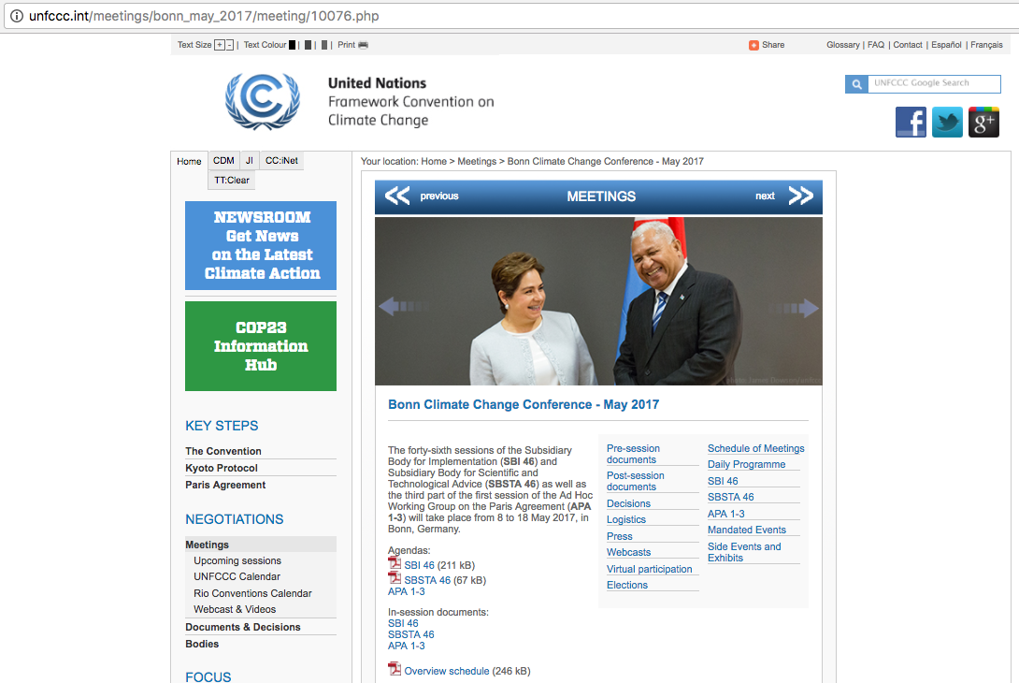
UNFCCC Online
The UNFCCC provides a lot of information through its Home Page, including information about official documents, working bodies, thematic areas, and the negotiations process.
For example, the UNFCCC has a page dedicated to COP23.
This page contains:
Logistical information about getting to COP;
Provisional agendas;
Daily programmes and meeting schedules;
In-session documents;
Webcasts;
UNFCCC documents and decisions.
UNFCCC Taskforce | COP23 | DT02_The UNFCCC

Slide 29
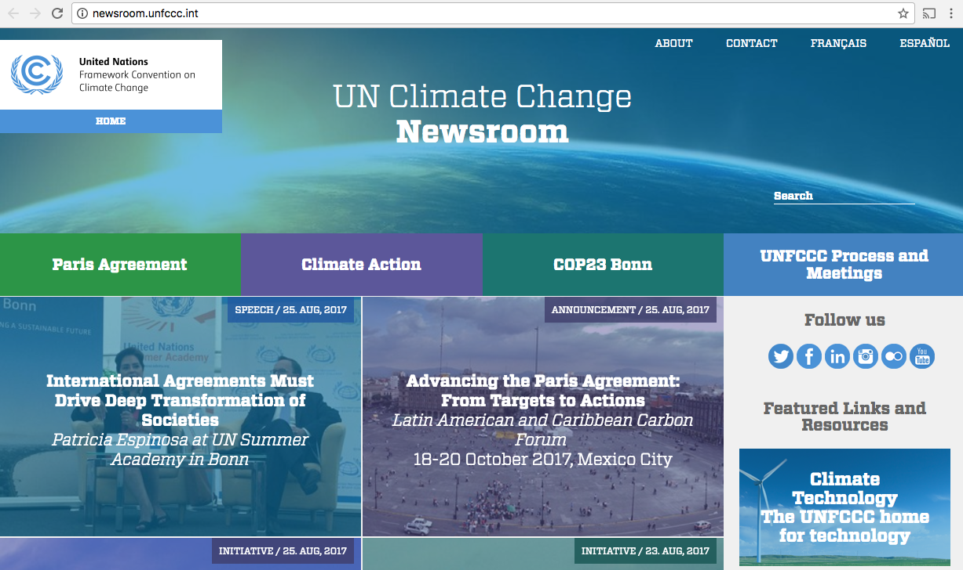
UNFCCC Online
The News Room contains additional information about the Paris Agreement and COP23.
UNFCCC Taskforce | COP23 | DT02_The UNFCCC

Slide 30
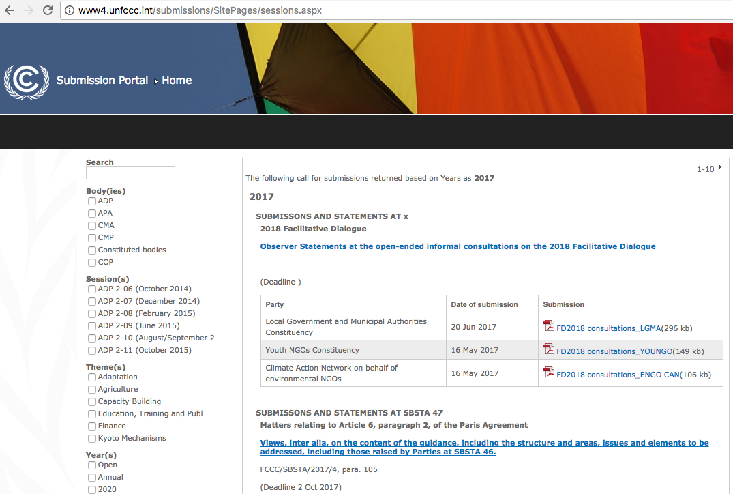
UNFCCC Online
The Submissions Portal lists all calls for submissions under the UNFCCC. The Portal lists the submission topics and technical body that has requested the submission.
Submissions are organised according to the Body that requested them and the negotiating session that they will be discussed at.
Anyone can view submissions that have been uploaded.
The NAB Sec has also developed a 2017 Submissions Schedule, available on the Google Drive.
UNFCCC Taskforce | COP23 | DT02_The UNFCCC
Notes:
Define submission under the UNFCCC – what can it encompass, who is responsible for uploading it, how are they used in the context of the negotiations?

Slide 31
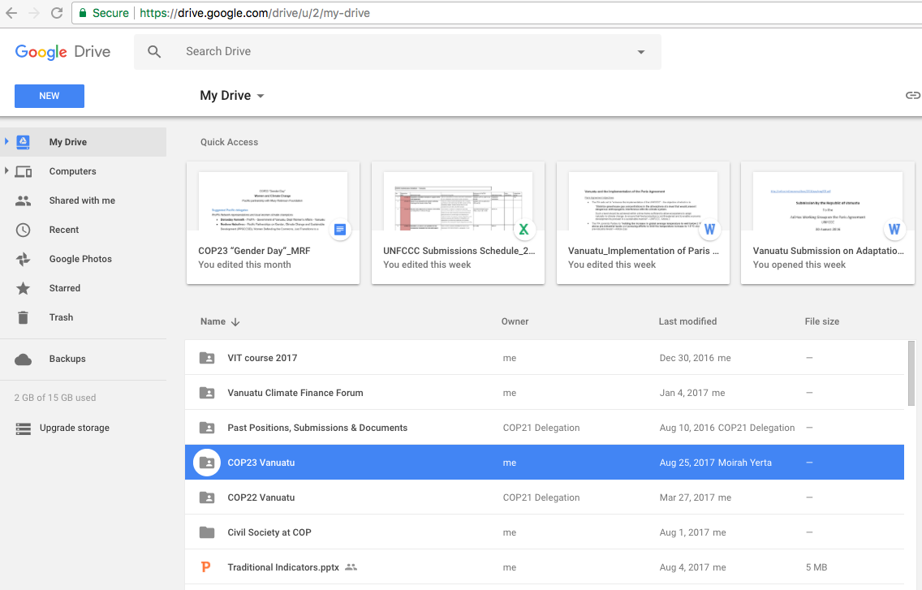
Vanuatu UNFCCC Google Drive
The UNFCCC Taskforce manages a shared Google Drive that holds all documents that are relevant to Vanuatu’s engagement with the UNFCCC. This Drive is owned by vanuatuunfccc@gmail.com.
Information in the Drive is strictly confidential, and is to be viewed by official COP Delegates only
There are folders dedicated to COP22, COP23 and Vanuatu’s past country positions and submissions.
If you have difficulty accessing the Drive, please contact nab@meteo.gov.vu
UNFCCC Taskforce | COP23 | DT02_The UNFCCC

Slide 32
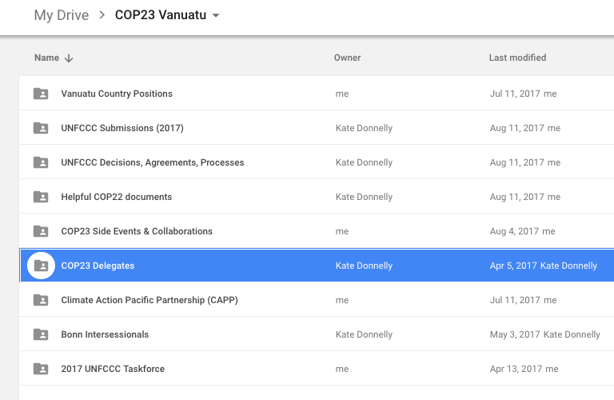
Vanuatu UNFCCC Google Drive
The COP23 Folder has a collection of resources that will be useful to delegates. This includes:
Official UNFCCC decisions and agreements (incl. the Convention and Paris Agreement);
Training resources and other readings for COP23 delegates;
Information about the intersessional negotiations that took place in May;
Folders for the Thematic Work Groups to work on country positions and submissions.
UNFCCC Taskforce | COP23 | DT02_The UNFCCC

Slide 33
Vanuatu UNFCCC Google Drive
Please Note
All COP Delegates were sent a link to access the Google Drive after the Induction training. While you do not need a Gmail account to access the documents on the Vanuatu UNFCCC Google Drive…
it is highly recommended that you use a dedicate Gmail account for all your COP work.
You will receive a high number of emails from Vanuatu’s negotiation groups, interest and news groups, and your delegation, especially during the negotiations. It is especially important that you do not miss any emails from the Delegation, which is likely to happen if you use your normal work email.
If you would like help to set up a dedicated COP email, please contact nab@meteo.gov.vu.
UNFCCC Taskforce | COP23 | DT02_The UNFCCC

Slide 34
Questions?
UNFCCC Taskforce | COP23 | DT02_The UNFCCC

Slide 35
Vanuatu COP23 Thematic Work Groups
Please Note
Most of the preparatory work that Vanuatu must complete prior to COP23 will be carried out by the COP23 Delegation Thematic Work Groups (TWG).
The members of each TWG are listed on the Google Drive.
TWGs are expected to meet face-to-face and communicate over email as often as needed to meet all relevant Submission deadlines.
It is recommended that each TWG elects a Chair to take notes, schedule group meetings and maintain contact with the UNFCCC Taskforce, with the support of the TWG Lead.
We have 10 minutes now for each TWG to meet and elect a Chair. Please let a representative of the NAB know who this person is.
UNFCCC Taskforce | COP23 | DT02_The UNFCCC

Slide 36
Next delegate training ! Thursday 14 September
UNFCCC Taskforce | COP23 | DT02_The UNFCCC

Slide 37
Key contacts: Chair of UNFCCC Taskforce: Sanlan Williams Strategic Manager of NAB Sec: Anna Bule NAB Sec: nab@meteo.gov.vu
UNFCCC Taskforce | COP23 | DT02_The UNFCCC

