Slide 1

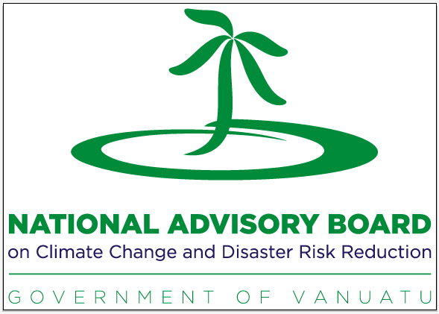
National Advisory Board on Climate Change and Disaster Risk Reduction (NAB)
NAB Secretariat Outreach Programme
May 24 to June 4, 2021

Slide 2
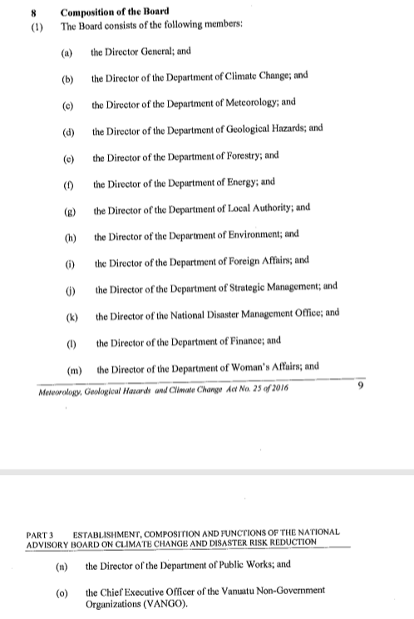
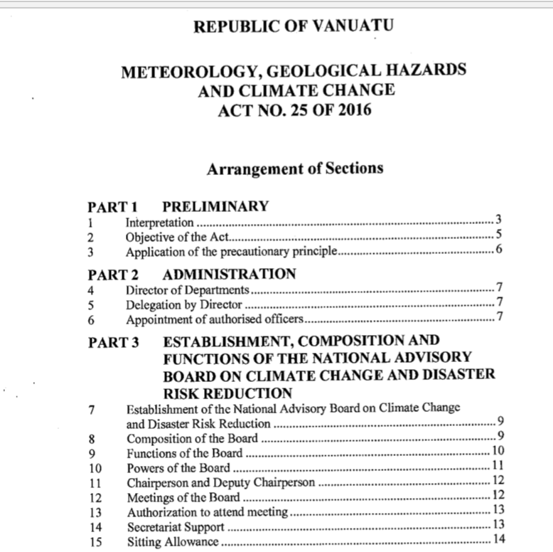
The National Advisory Board
The NAB is now established under the Meteorology, Geo-hazards and Climate Change Act No.25 of 2016
It’s primary purpose is to act as the advisory body and policy making body for all climate change and disaster risk reduction programs, projects, initiatives and activities
Its aim is to integrate the governance of CC&DRR in an integrated and holistic way to reduce duplication
This increases collaboration of work, and provides a consistent approach, which in turn addresses Vanuatu’s priorities
The Board meets every two (2) months
The Board is supported by the a Secretariat (“NAB Secretariat”)
Notes:
History:
Was formed from an amalgamation of the National TaskForce on DRR and the National Advisory Committee on Climate Change; because the same actors were appearing in both arenas [same people who were working in CC were the same ones working in DRR, in addition, international and regional policies were also changing to combine the two thematic areas]
In 2012 the Council of Ministers (COM) approved the formation of the NAB

Slide 3
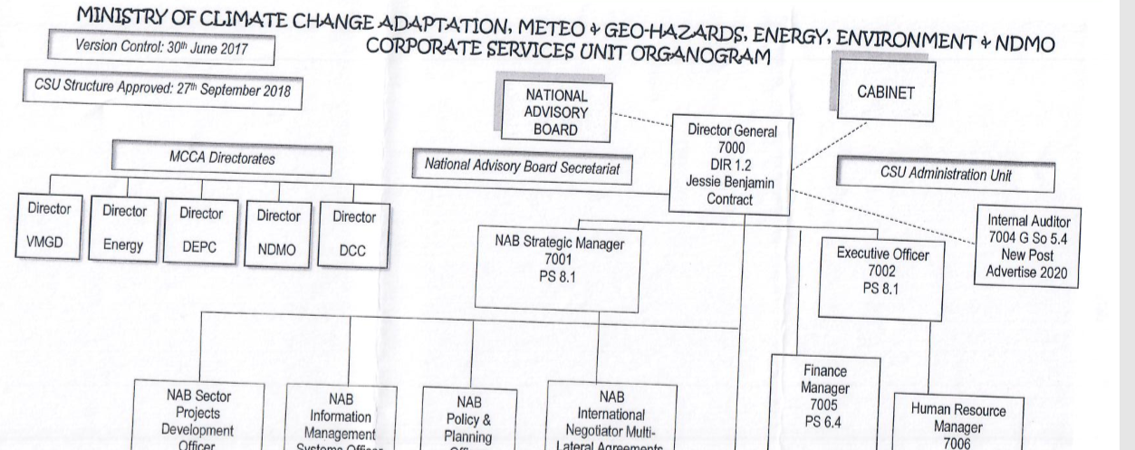
The NAB and the MoCC
Notes:
Chairman of the NAB is the Director General of the Ministry of Climate Change
The Secretariat of the NAB sits in the Corporate Services Unit (CSU) of the Ministry, and is Supervised by the DG
The Directors of all the Departments in the Ministry are members of the Board, membership also includes other Government agencies

Slide 4
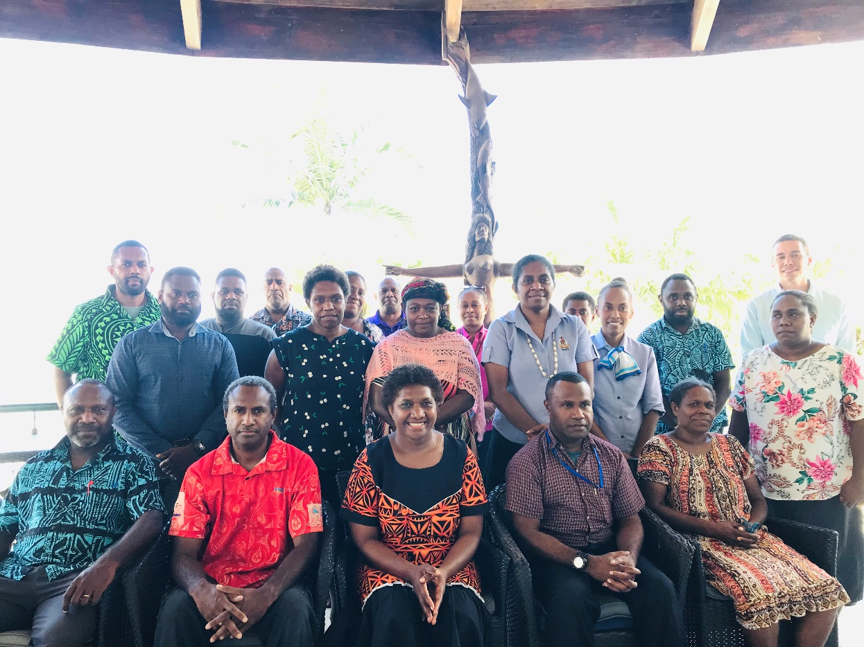
Who is on the NAB?
It is chaired by the DG Climate Change, he is allowed to appoint an Alternative
Members are Directors of CC, Meteo, Forestry, Energy, Local Authorities, DEPC, Foreign Affairs, DSPPAC, NDMO, Finance, Women’s Affairs, Public Utilities, CEO of the VANGO
Observers Secretariat of the VCAN and the Chair of the Vanuatu Business Resilience Committee (under the VCCI)additional observers and visitors are welcome to attend NAB meetings on an invitation basis
Notes:
[as mentioned previously] Director General of MCCA is the Chair, according to the Act, he is allowed to select an “Alternate” when he is unable to Chair
There are a total of 14 members of the Board (incldg the DG). Quorum of the NAB is 8 members (“half plus 1”)
The Act makes allowances for there to be Observers on the Board; they are allowed to take part in discussions, but not in the decision-making (note: this means if there is no quorum, but there are Observers present, there can be a discussion on an agenda item, but no decision can be taken. Whether a meeting goes ahead or not if there is no quorum is at the discretion of the Chair)
Observers are representatives of the climate change- CSOs, and the Vanuatu Chamber of Commerce and Industry
Members are allowed to request for guests to come to a Board meeting, especially when there is a particular agenda item that needs to be discussed

Slide 5
The work of the NAB
The NAB is supported by several sub-committees; these carry out specific functions
The Project Screening Committee (PSC)
The United Nations Framework Convention on Climate Change Taskforce (UNFCCC TF)
The Climate Finance Working Group (CFWG)
Climate Diplomacy Task Force (CDTF)
Facilitation of Information and Communication materials’ endorsement
Notes:
As explained in the beginning, the NAB is the overarching body responsible for policy advice in all matters related to CCDRR. It has 6 main duties, including; It provides advise on international, regional and national DRR and CC obligations. It provides advise, facilitates and endorses the development of new DRR&CC programs/projects/initiative and activities (mainstreaming CC&DRR). Acts as a focal point for information sharing and coordination for CCDRR. Provides advise, guides and coordinates development of national CCDRR financing processes
To assist the NAB carry out its functions, the NAB has working groups, made up of NAB members’ technical officers and other stakeholders (listed on the slide)

Slide 6
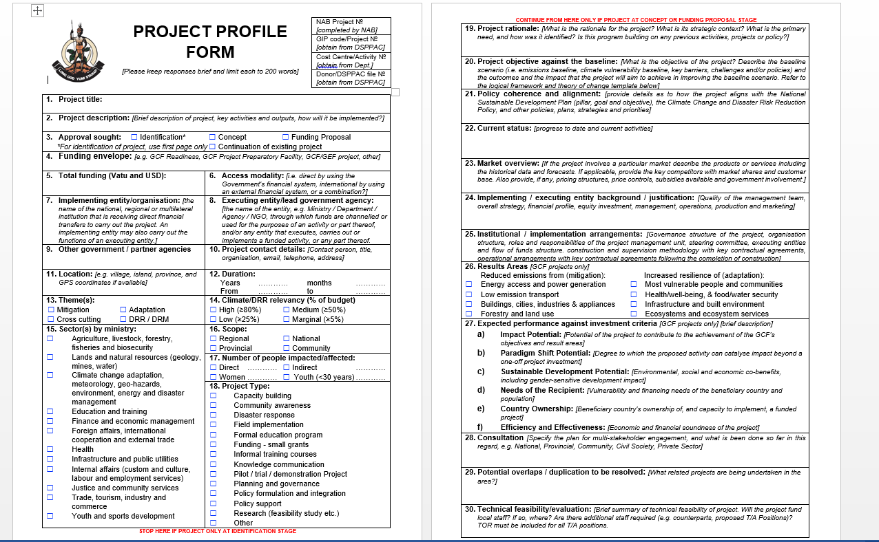
The work of the NAB- Screening
& Endorsing Projects & Programs
Projects, programs, research work that want to be implemented by donors and partner agencies, or individuals are brought to the NAB
Expedite the project appraisal processes by screening and making recommendations to the NAB proposed climate change and disaster risk reduction projects submitted to the NAB Secretariat
The Project Screening Committee screens proposals to ensure it meets several criteria, such as mode of financing, local implementing partners, government priorities, collaboration of other projects with similar objectives
PSC- made up of the DSPPAC, VCAN, Finance, Women’s Affairs, VMGD, NDMO, DLA [DoCC], DEPC
Notes:
Purpose of the NAB is to oversee and coordinate everything CC and DRR related. So we have projects, research, anything climate or disaster risk-related that people want to do in VT, they must first get approval from the NAB before work begins. (As stated previously, the NAB provides advise, facilitates and endorses the development of new DRR&CC programs/projects/initiative and activities (mainstreaming CC&DRR)
Project Screening Committee screens all applications that come into the NAB, they make recommendations to the Board on whether the project can go ahead or not. The PSC will look at things like: where (project site) it is being carried out, does it meet with Government priorities (NSDP, Sector Policy), how is money being brought into the country? (FMIS? TA? Outside government system?), which Departments will it work with etc.

Slide 7
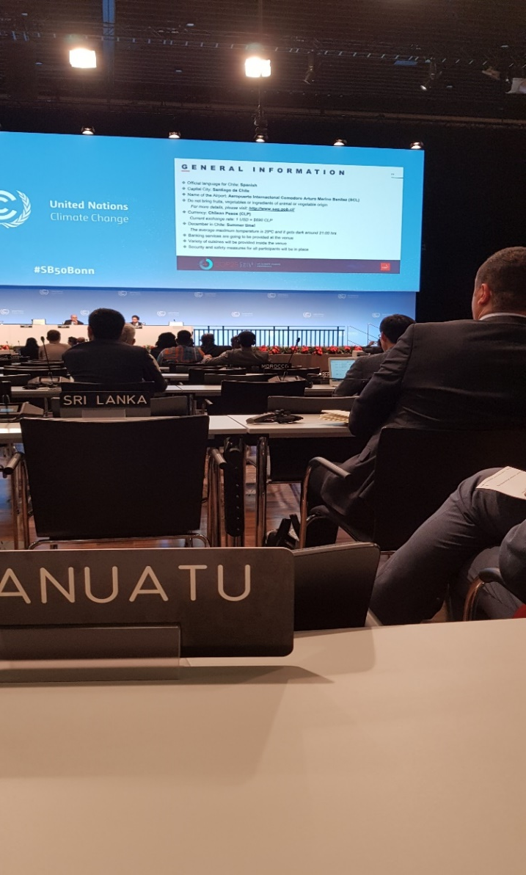
The work of the NAB- UNFCCC
Taskforce (UNFCCC TF)
The UNFCCC Taskforce’s primary role is to assist plan, share information about, seek finance for and delegate the implementation of all initiatives related to Vanuatu’s engagement with the UNFCCC
Oversees/coordinates the implementation of decisions of the Convention
There are currently 22 confirmed delegates; representatives are from Government, NGO, Private Sector.
Work is underway to prepare for the negotiations at the end of the year
The Twenty-sixth Conference of Parties (COP) is in Glasgow in Scotland, from November 1-12
Notes:
Point 2: generalized statement that encompasses different aspects of the UNFCCC process such as the Nationally Determined Contributions, the National Adaptation Plan, Biennial Update Report, Third National Communications, Gender Action Plan
(It provides advise on international, regional and national DRR and CC obligations)
Every year countries meet to discuss what they are doing in-country to meet their international commitments, what problems/ challenges we have and what kind of help we can access.
NAB coordinates Vanuatu’s participation at the international and regional meetings; at these meetings we share experiences on how we carry out our obligations.

Slide 8
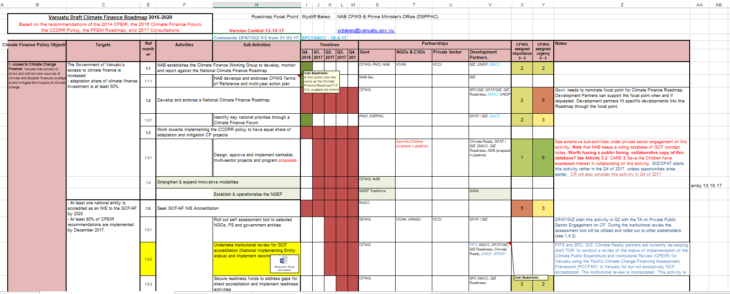
The work of the NAB- Climate Finance
The Climate Finance Working Group serves as a consultative arm of the National Advisory Board to provide strategic direction specifically on climate finance related matters for the Ministry of Climate Change and the Government of Vanuatu.
The CFWG shall assist the NAB Secretariat to resolve compliance issues raised in leading to National Implementation Entity status. The order of the items reflects no importance or priority
The CFWG shall work on and oversee the development of the Climate Finance Roadmap and Action Plan aligned with several national policies, including the NSDP.
Notes:
Climate Finance Working Group will assist the NAB Secretariat to progress issues related to climate finance. The CFWG’s purpose is to serve as a consultative arm of the National Advisory Board to provide strategic direction specifically on climate finance related matters for the Ministry of Climate Change and progress the NIE Accreditation agenda
There are 2 strategic documents that guide the work of the CFWG; the CF Roadmap and the GCF Country Programme. The Roadmap identifies priority activities that we would like to carry out. The Country Programme is a collection of concepts/ideas of projects and programmes in each sector (e.g. renewable energy, water sector)

Slide 9
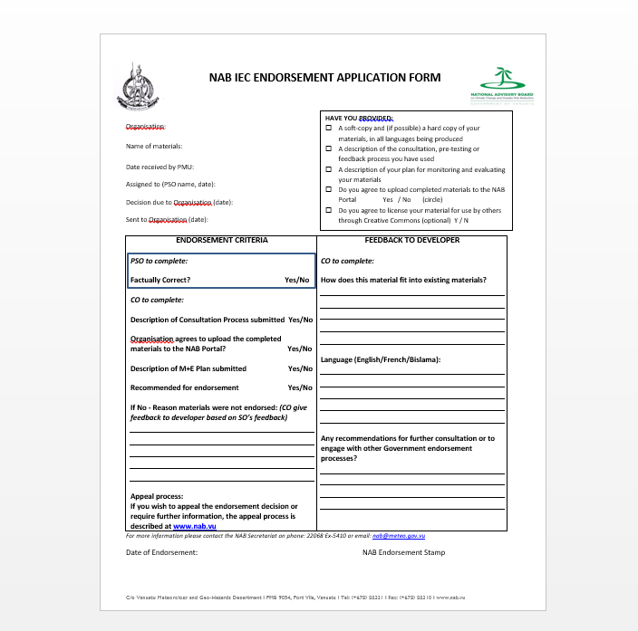
The work of the NAB- Information Materials
Awareness materials with messages on CCDRR standardized
Organizations/people submit materials to NAB Sec. Materials are given to Scientific Officers (e.g. DRM: Alice @ NDMO, CC: Nelson, Pauliane and VMGD Climate staff) to screen and ensure language is accurate
Form/materials approved with the NAB logo given as endorsed
Materials then uploaded to NAB Portal
Notes:
The NAB also ensures that the Government has standard messages that go out to the public. When an entity has any awareness materials (e.g. brochures, posters, booklets etc) they submit the materials to NAB and we arrange for technical staff to check for consistency of terms (NDMO, DoCC). Once officers have “ok’ed” the language, we send the approval with the NAB logo for them to include.

Slide 10
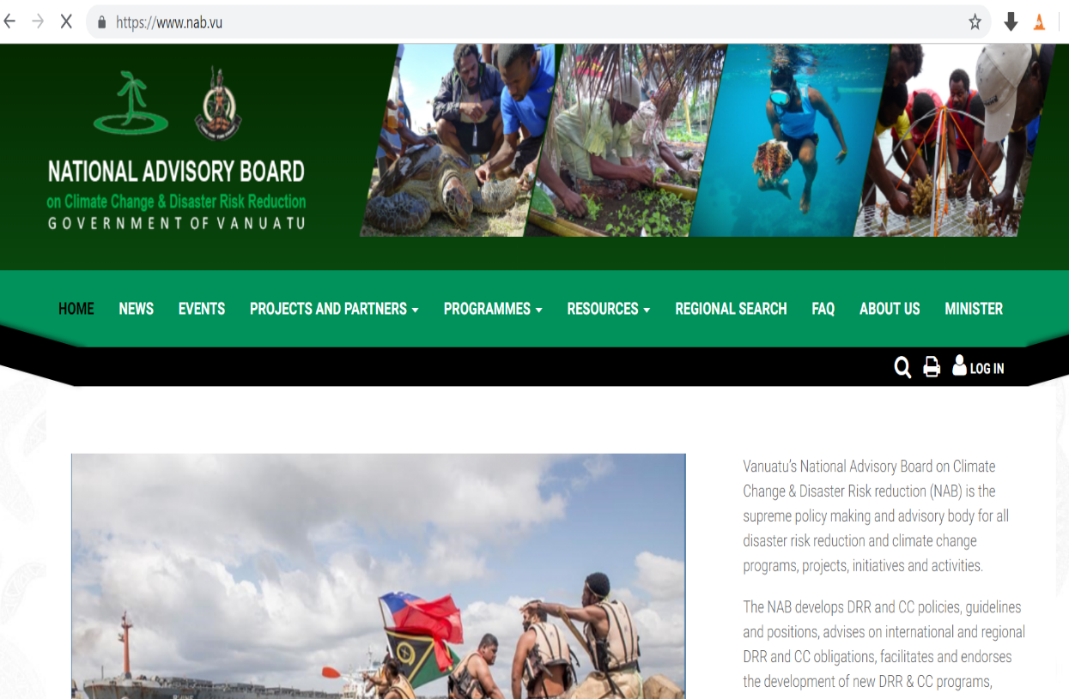
Coordination Tools and contacts of the NAB Sec
The NAB portal: www.nab.vu
It is a place to access and share information
Contact points to get involved in the NAB:
  NAB Secretariat, nab@vanuatu.gov.vu
Notes:
The NAB portal is akin to a library that stores information about CC, not just about Vanuatu but also regional and international. It has information about projects, policy documents, adverts.

Slide 11
Thank you tumas

