Slide 1
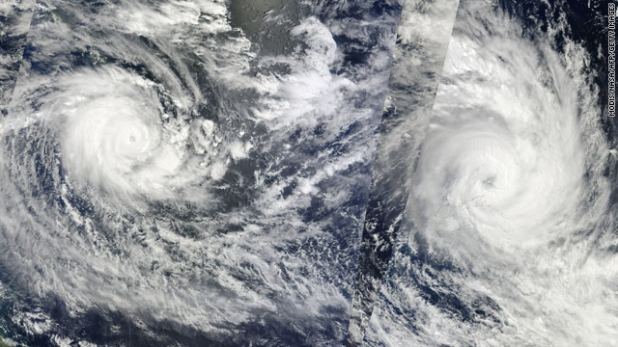
SPC-GIZ Pacific German Coping with Climate Change in the Pacific Islands Region Project
Dr. Christopher Bartlett

Slide 2
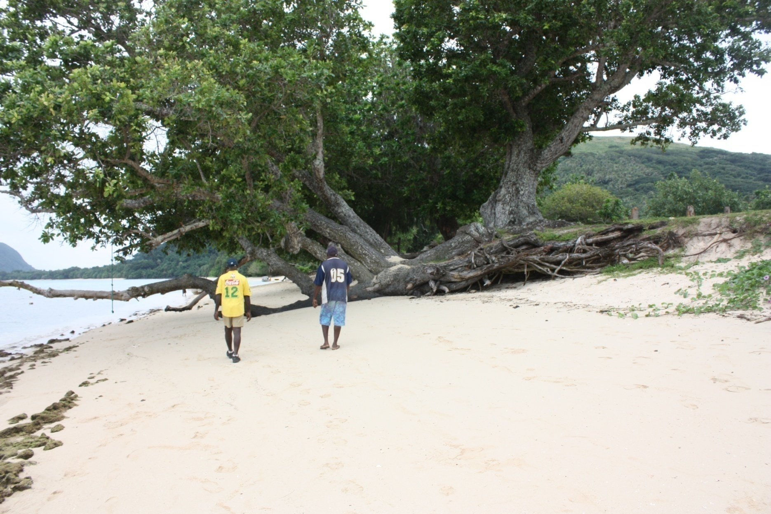
Sea Level Rise in Vanuatu
Notes:
The global average sea level rose by close to 20 centimetres between 1870 and 2007.
Sea levels rose at an average of 1.7 millimetres per year during the 20th century, and 3.4 millimetres per year from 1993 to 2007.

Slide 3
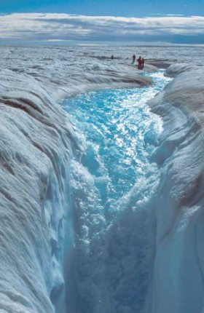
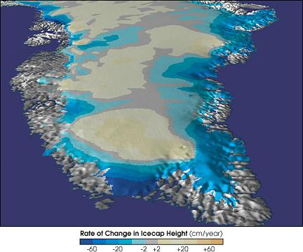

Slide 4
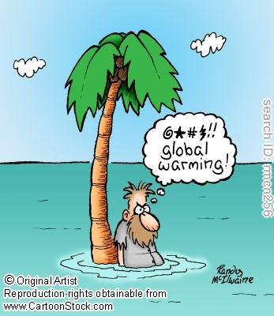
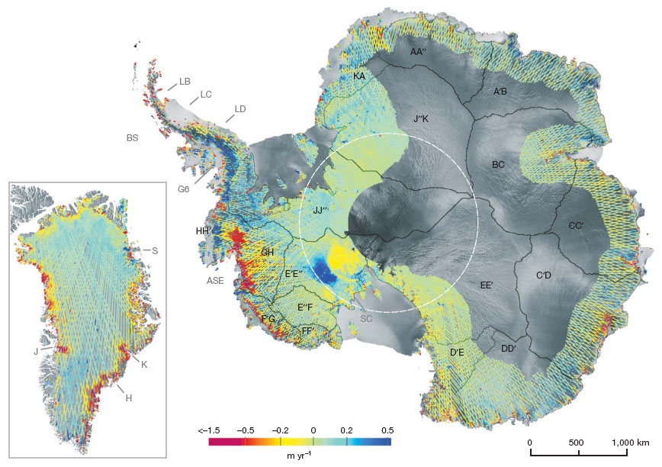

Slide 5
Hamas?
The 2007 IPCC report stating an anticipated global sea level rise ranging from 18 cm to 59 cm (IPCC, 2007).

Slide 6
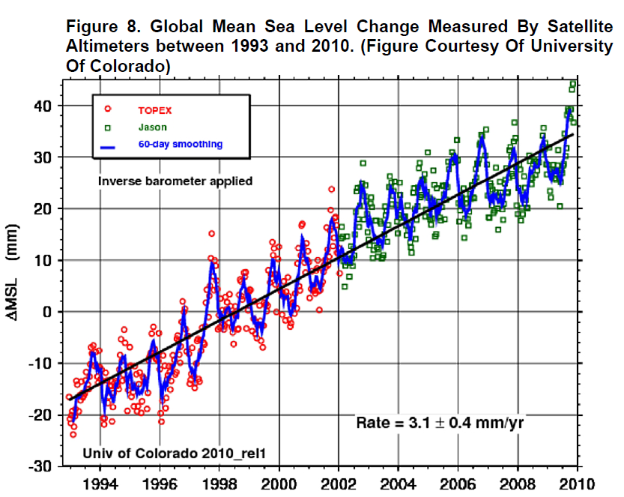

Slide 7
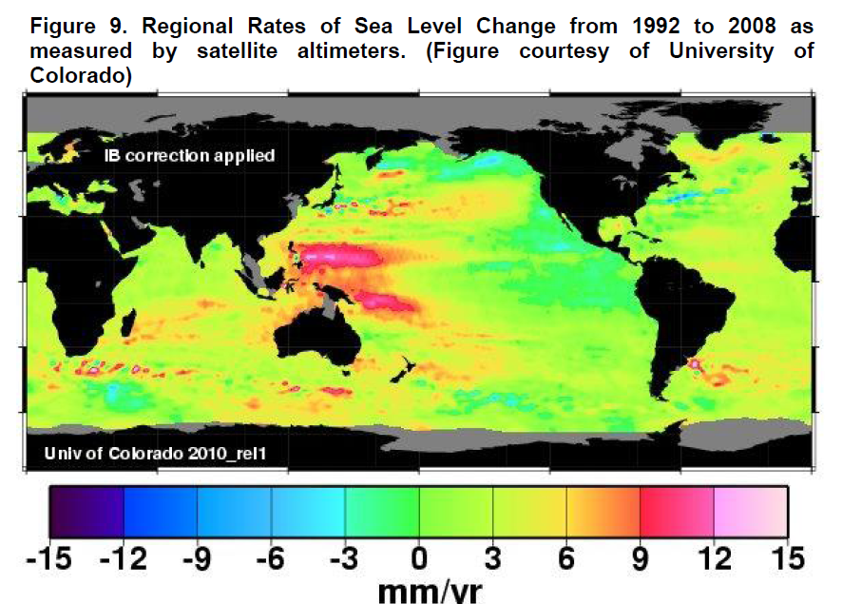

Slide 8
The projections for the Pacific are expected to follow the global trend. Of course, sea levels are not static and naturally fluctuate over time, and in the Pacific there is considerable variability “associated with the El Niño-Southern Oscillation, (Church et al., 2006, p. 157).
This is especially evident during abnormally high tides (such as king tides) that can be considerably higher than the average local sea level.
Under increasing climate-induced sea level rise, the occurrence of extreme tide events is projected to increase.

Slide 9
Sea level is controlled by many factors, some periodic (like the tides), some brief but violent (like cyclones), and some prolonged (like El Niño),
In Vanuatu, tides are predominantly diurnal, or once daily, while elsewhere the tide tends to have two highs and two lows each day.

Slide 10
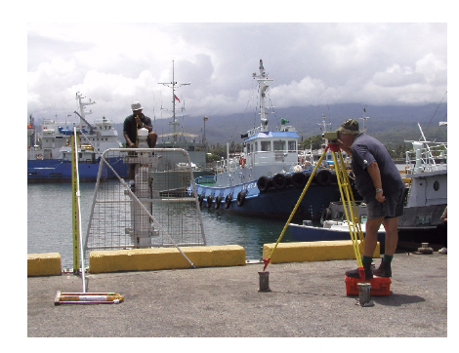
TIDE MONITORING IN VANUATU
A SEAFRAME gauge was installed in Port Vila, Vanuatu, in January 1993. It records sea level, air and water temperature, atmospheric pressure, wind speed and direction.

Slide 11
When change in sea level is measured with a tide gauge over a number of years one cannot be sure whether the sea is rising or the land is sinking.
To local people, the relative sea level change is of paramount importance.
Vertical movement of the land can have a number of causes, e.g. island uplift, compaction of sediment or withdrawal of ground water.

Slide 12
Continuous Geographical Positioning Systems (CGPS) are final link in establishing vertical datum control – that is, to determine whether the island or coastal region as a whole is moving vertically with respect to the International Terrestrial Reference Frame.

Slide 13
Atmospheric pressure is another parameter that can potentially influence relative sea level rise. Known as the inverted barometer effect, if a 1 hPa fall in barometric pressure is sustained over a day or more, a 1 cm rise is produced in the local sea level (within the area beneath the low pressure system).

Slide 14
TIDE MONITORING RESULTS THROUGH 2009
● The sea level trend to date is +6.5 mm/year. Accounting for the precise levelling results and inverted barometric pressure effect, the trend is +5.6 mm/year.
● Variations in monthly mean sea level include a moderate seasonal cycle and were affected by the 1997/1998 El Niño.
The effects of the vertical movement of the tide gauge platform and the inverse barometer effect are removed from the observed rates of relative sea level change. The net sea level trends are positive at all sites, which indicates sea level in the region has risen over the duration of the project.

Slide 15
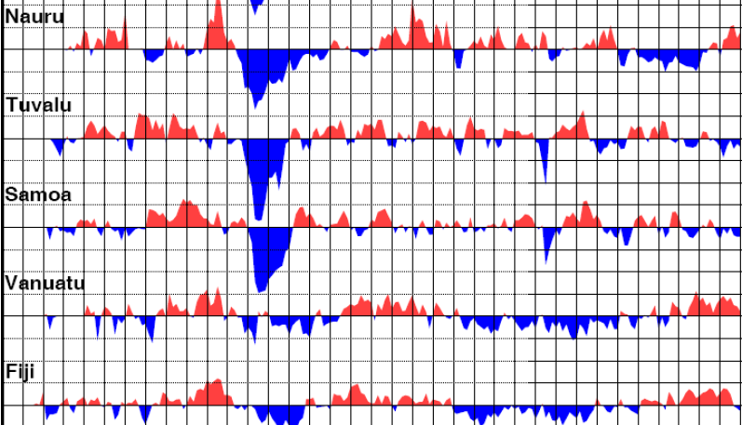

Slide 16
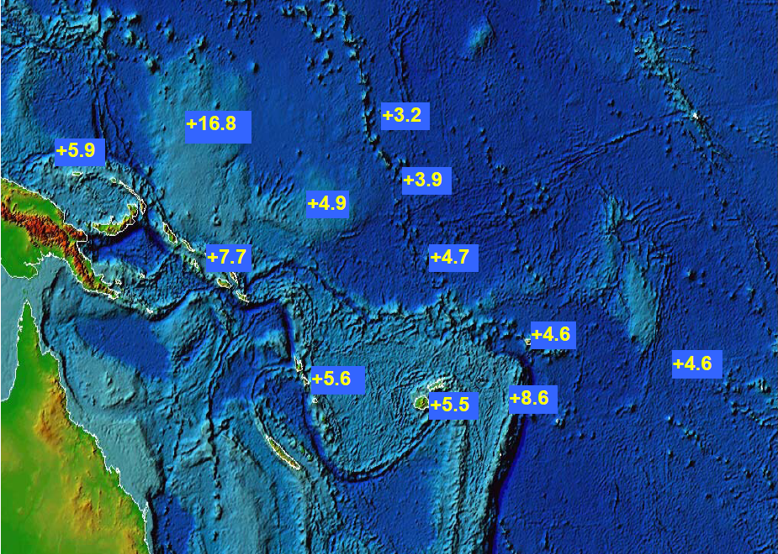

Slide 17
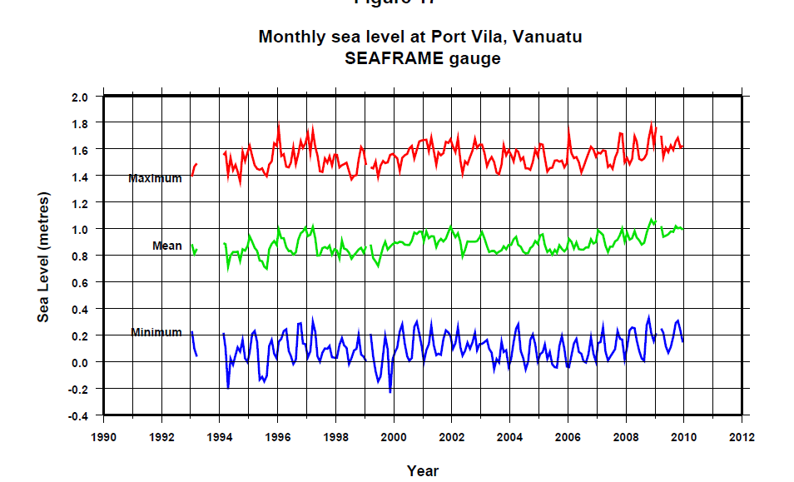

Slide 18
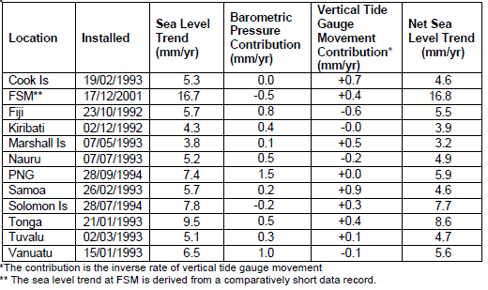
Currently, the sea level rise for Vanuatu is 5.6 mm per year (1993–2009) (AusAID, 2007).
Source: AusAID (2009) p. 12

Slide 19
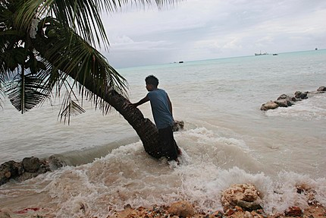
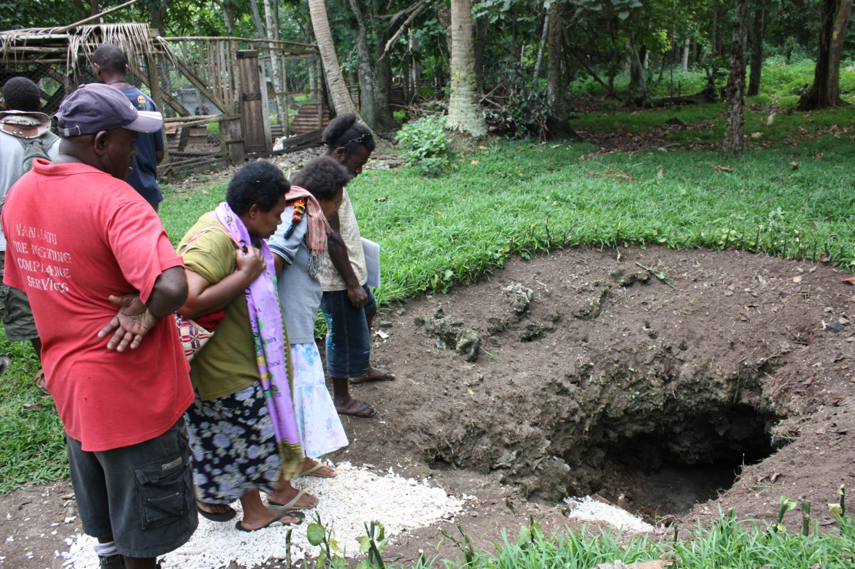
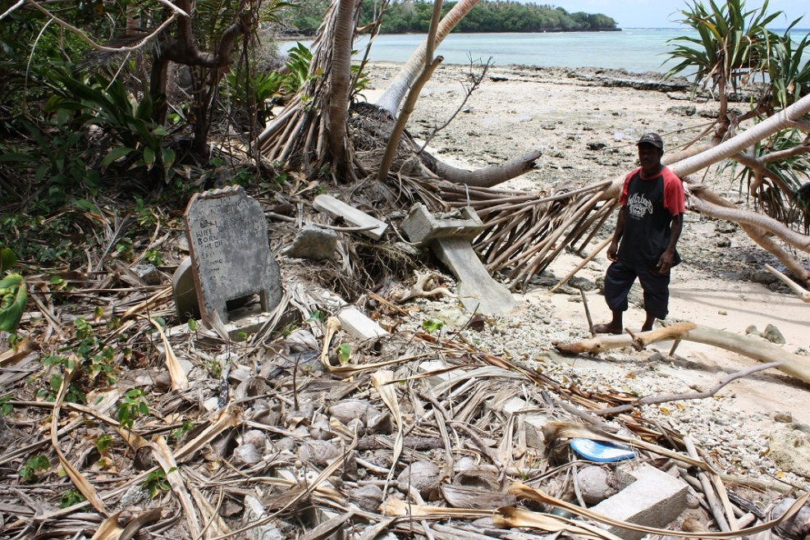
Bae i minim wanem long yumi?
Crops:
Salt Spray
Humans:
GrounWota contamination
Loss of Land – Resettlement
Beach:
Erosion
Infrastructure:
Roads mo Airports

