Slide 1
VANUATU CLIMATE CHANGE (NAB) PORTAL
NAB Portal User Training and Awareness Workshop
Tuesday 19th and Thursday 21st July 2022
Port Vila, Vanuatu
National Advisory Board on Climate Change and Disaster Risk Reduction,
Ministry of Climate Change

Slide 2
Presentation Outline:
What is NAB?
What is the NAB Portal?
Brief overview of the nab portal
Why do we have the nab portal ?
Benefits of the nab portal
Outputs/Outcomes achieved
Lessons learned
Challenges
recommendations

Slide 3
What is NAB?
‘NAB’ is short for National Advisory Board on Climate Change & Disaster Risk Reduction ( CCDRR) – COM endorsed in Oct. 2012
The NAB is now established under the Meteorology, Geo-hazards and Climate Change Act no.25 of 2016
It’s primary purpose is to act as the advisory body and policy making body for all climate change and disaster risk reduction programs, projects, initiatives and activities
Its aim is to integrate the governance of CC&DRR in an integrated and holistic way to reduce duplication
This increases collaboration of work, and provides a consistent approach, which in turn addresses Vanuatu’s priorities
The board meets every two (2) months
The board is supported by the a Secretariat (“NAB Secretariat”)
Acts as a focal point for information - Sharing and coordination on CC/DRR. Its primary Information Management tool is the NAB Portal
AIM: To integrate the governance of CC&DRR in an Integrated and holistic way to reduce duplication.
Notes:
History:
Was formed from an amalgamation of the National TaskForce on DRR and the National Advisory Committee on Climate Change; because the same actors were appearing in both arenas [same people who were working in CC were the same ones working in DRR, in addition, international and regional policies were also changing to combine the two thematic areas]
In 2012 the Council of Ministers (COM) approved the formation of the NAB

Slide 4
What is the NAB Portal?
The NAB portal – https:\\www.Nab.Vu, is a website that provides access to a wealth of almost all of Vanuatu's CCDRR information including:
Policies,
Events,
Current news,
Documents,
UNFCCC engagements,
Jobs opportunities,
A directory of useful contacts,
The projects profile of each project endorsed by NAB
And insights into the developments and priorities of the CCDRR sector on a national scale.
It is the Primary Information Management tool for the CCDRR information’s of Vanuatu.
The nab portal is managed by the secretariat of the nab that sits within the corporate services unit in the ministry of climate change (MoCC). The NAB secretariat, with its collaborating partners, continue to ensure the validity of the NAB portal contents over the years.
Notes:
The NAB portal is akin to a library that stores information about CC, not just about Vanuatu but also regional and international. It has information about projects, policy documents, adverts.

Slide 5
BRIEF OVERVIEW OF THE PORTAL
Launched in August 2012 by Vanuatu government to improve IKM round CC & DRR (10 years this year 2022)
In line with pacific climate change portal (PCCR-2012)
The “NAB portal” is a Vanuatu website - CORDINATION TOOLS, CONTACT LISTS and a RESOURCE DATABASE.
It is a place to access and share information.
The nab portal is unique - user-owned, decentralized
CCDRR sectors and agency focal points invited to access the website and update their own information
Notes:
The Vanuatu NAB portal was initially funded by GIZ in 2012 and was later upgraded through funds from the regional technical support mechanism (RTSM) administered by SPREP in partnership with the pacific iCLIM project implemented by the Griffith university in Australia.
Until then the portal has never been upgraded.

Slide 6
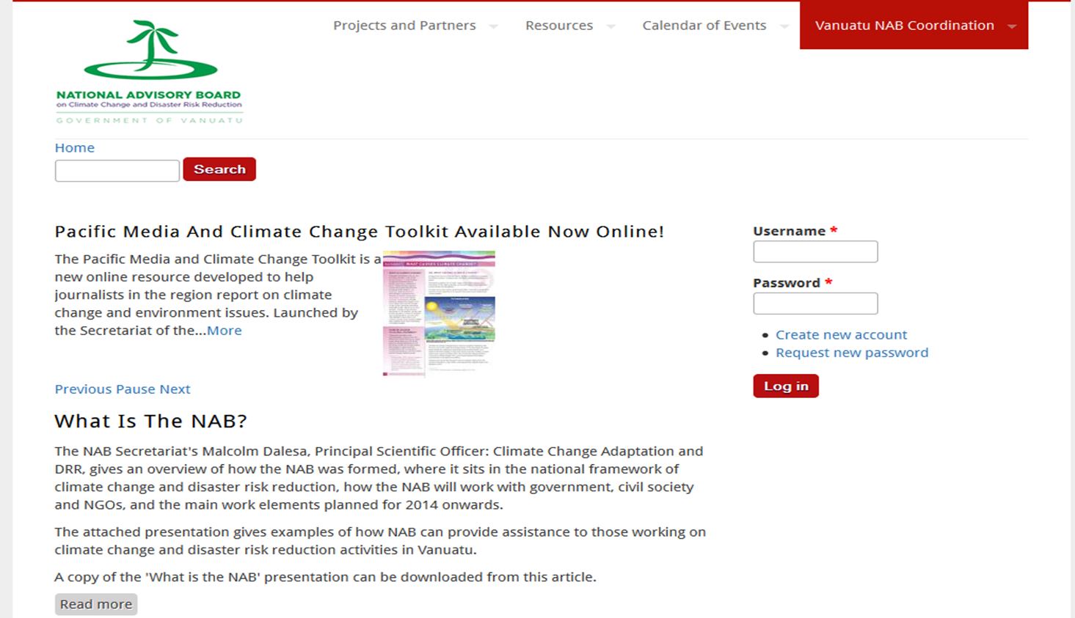
Portal home page (2012 – 2013)

Slide 7
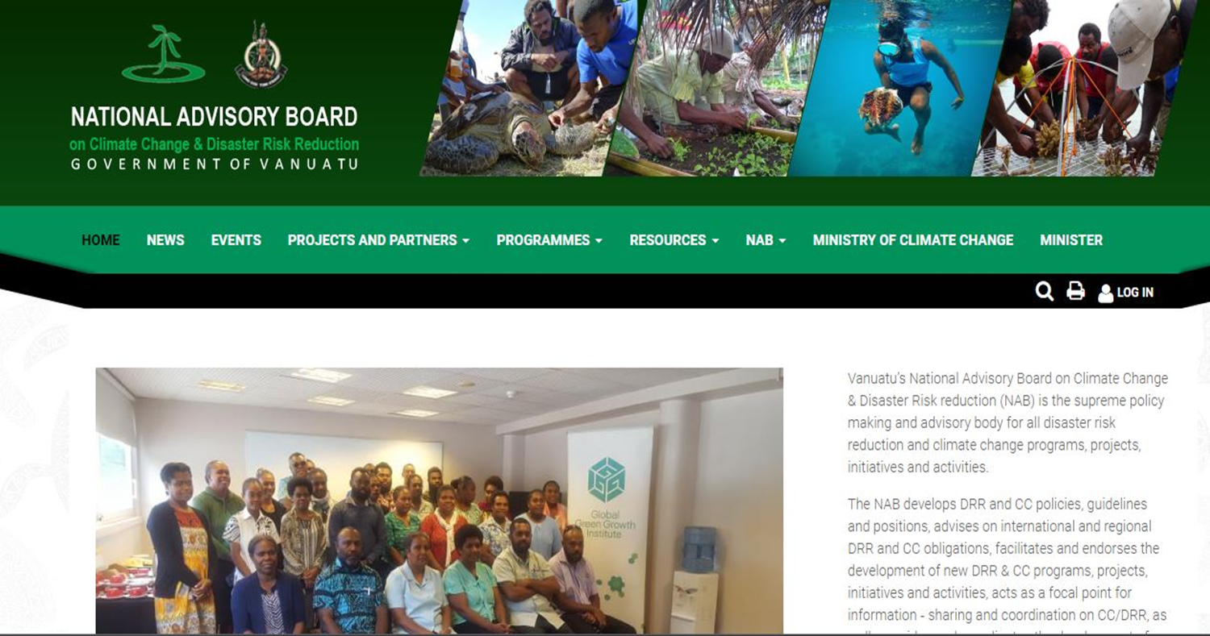
Portal home page 2014 - 2022
Notes:
ICLIM Project with SPREP – through the Vanilla Package made the changes

Slide 8
Why do we have the NAB Portal?
Because it is:
Is a resource database that will be useful for any researcher, community, or interested individual seeking Vanuatu climate change and disaster risk reduction (CCDRR) information’s.
It is a content on the portal that includes, news items, planned events, past and current project information, contact lists and educational resources, UNFCCC elements and CCDRR policies and strategy.
And also a coordination tools that allow organizations in Vanuatu to contribute to climate change and DRR information to this central information portal.

Slide 9
Benefits of the NAB Portal
The portal is a user-friendly knowledge management tool, means anyone who have access with a given password or username by the NAB secretariat, he/she can login to the portal to upload documents, and other resourceful things to the portal that are related to CCDRR information.
As a NAB portal user, you are encouraged to upload your climate change and disaster related content ( like contacts, documents, events ( related to CCDRR) and news.

Slide 10
Outputs Achieved
Centralized storage database of important CC/DRR policies, plans, reports and strategic documents
Mechanism via shared online calendar for event coordination
Centralized list of national CC/DRR contacts and focal points & NAB members.
Regular news and current affairs updates for program information sharing
Contacts referral tool for students/researchers/project developers

Slide 11
Outcomes Achieved
More people (domestic and international) are aware of CC/DRR initiatives in Vanuatu
Improved coordination and communication between government and non-government stakeholders
Reduced duplication of CC/DRR efforts geographically and thematically
Increased financial flows due to improved accessibility of donors to local priorities
Greater participation of civil society in strategic meetings and events (public calendar of events)
More transparency in CC/DRR decision-making (project documents and reports available online)
Strengthening networks and partnerships of CC/DRR stakeholders

Slide 12
Lessons Learned
User-driven administration forces project managers to reference SRDP objectives/indicators when they upload projects/reports to portal
Users require incentives to utilize portal (e.g. Publicity, mandatory project endorsement requirement etc)
There is a need for regular capacity building/training for key gov and civil society stakeholders on portal content management (due to constant CCDRR staff turnover)
NAB portal backup systems are essential, yet often expensive not considered until a crash
GIS integration into qualitative data structures
Portals realistically available within Port Vila and Luganville (urban centers) with good internet access
The portal is the working hub and public interface for DD/DRR information management

Slide 13
Challenges
Integration of the NAB portal with pacific portal
Technical engineering of the portal (shortage of staff at ICT division)
Connection issues; regular internet outages
Finding the balance between decentralized and centralized content management
Time constraints for users to upload their own content
Space and environmental constraints to server management

Slide 14
Recommendations
Government and development partners to allocate additional dedicated financial and HR resources to support the portals
Links between the NAB portal with the PCCP needs to be developed further – to ensure full and automated connectivity (e.g. Seamlessly capturing regional and national projects)
Functionality of portal to be expanded from “who does what where” to interactive and high level data management and analysis.
Expand Vanuatu’s nab portal model to other pacific island countries

Slide 15
Portal User Needs Assessment Survey
Link: https://ee.humanitarianresponse.info/x/ityc5ssa (kobo toolbox)
Its Purpose is to:
For users to provide feedbacks and to share expeiences on accessing the Portal
Gather necessary information for the Portal upgrade
Upgrade will enhance the portal to be more discovery and accessible to everyone.
Survey end of July 2022.
Notes:
We are inviting you to be part of this survey, here is the link: https://ee.humanitarianresponse.info/x/ityc5ssa click on this link or copy this link to a web browser to start this user & needs assesment survey.
We look forward for your participation, your participation on this online survey will be very important since it will provide information that will enhance in the upgrade of the nab portal to be more discovery and accessible to everyone.

Slide 16
END

Slide 17
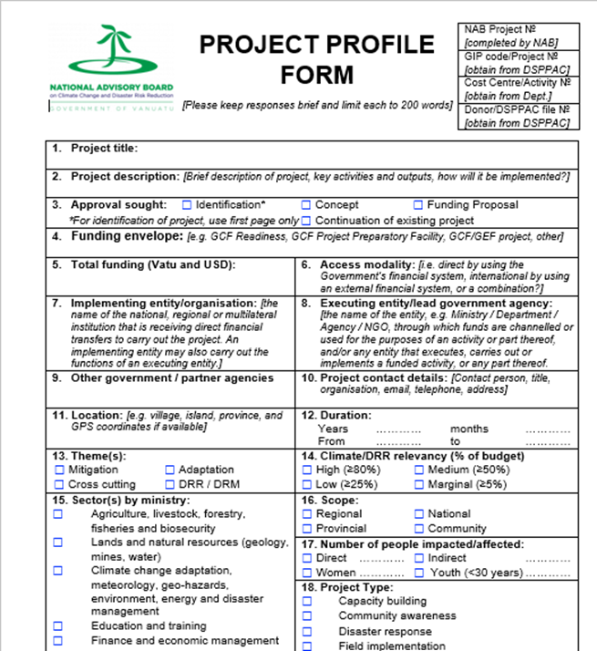
NAB Project Endorsement Process
What do you do?
Project idea, concept- speak to the NAB sec. We can guide you on whether the project is feasible.
Complete the form, submit to NAB Sec and we can revert with recommendations.
These are tabled at NAB meetings and endorsed
Project’s reports, products, profiles, maps uploaded into Portal
Notes:
The NAB was set up to coordinate CC projects, programmes, activities, initiatives
MCCA is the focal point to financing mechanisms of the climate change convention (Global Environment Facility/GEF and Green Climate Fund)
In order to ensure initiatives are coordinated, there are established processes that we encourage stakeholders to follow.
Projects that have climate change aspects are encouraged to pass through these processes to avoid duplication and address areas of need in an effective manner

Slide 18
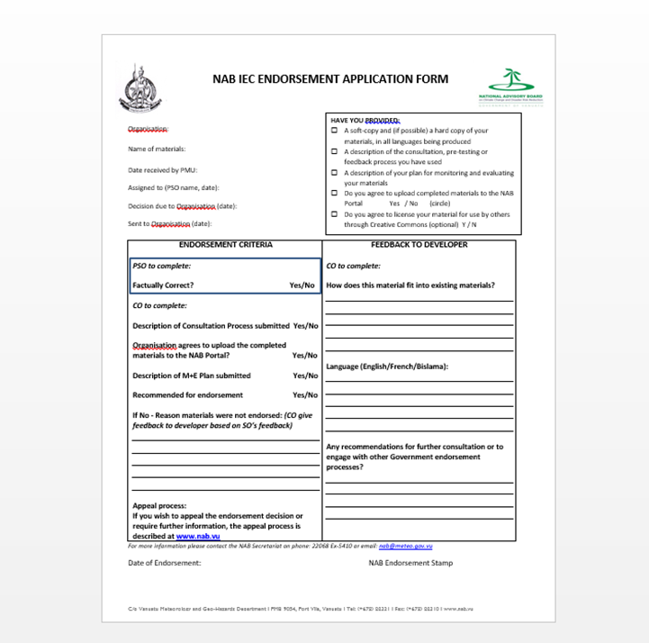
NAB IEC Endorsement Process
What do you do?
Awareness materials with messages on CCDRR standardized
Organizations/people submit materials to NAB sec. Materials are given to scientific officers (e.g. DRM and CC PSO staff) to screen and ensure language is accurate and factually correct in messages
Form/materials approved with the NAB logo given as endorsed
Materials then uploaded to NAB portal
Application Forms (Portal)
Notes:
The NAB also ensures that the Government has standard messages that go out to the public. When an entity has any awareness materials (e.g. brochures, posters, booklets etc) they submit the materials to NAB and we arrange for technical staff to check for consistency of terms (NDMO, DoCC). Once officers have “ok’ed” the language, we send the approval with the NAB logo for them to include.
Information materials; materials with messages are CC and DRR also come through the NAB Sec; this is to make sure there is consistency and factually correct in messages being put out

Slide 19
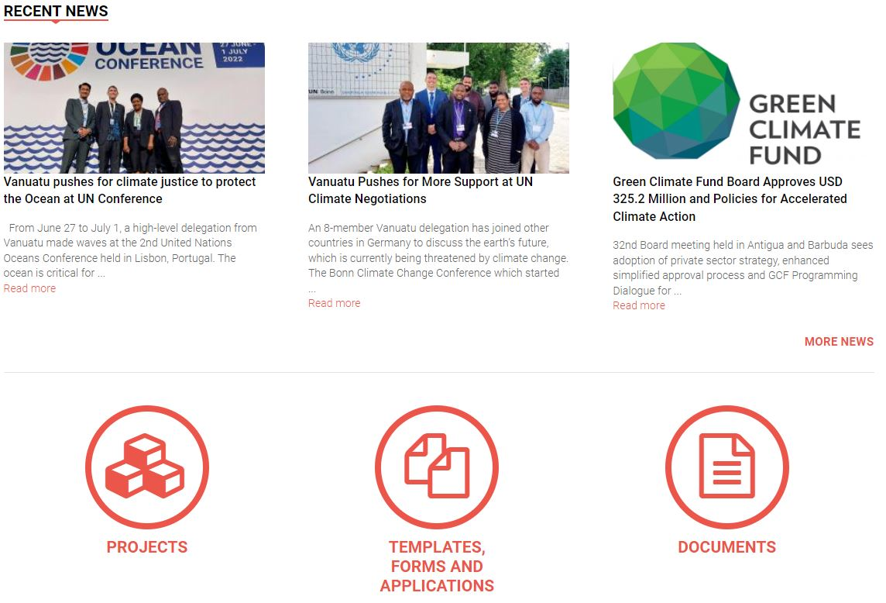
Way Forward
User Needs Assessments
Upgrade of the NAB Portal
Data collection, Auditing
Portal and Training
Provincial Portal Awareness

Slide 20
Thank You

